Slide 1
Machine Language

Slide 2
Instructions
2 types of commands: operations and access
Operations: arithmetic and boolean
Arithmetic
Eg. Set R2 to R1 + R3
1010001100011001 (16-bit computer has four 4-bit fields)
Boolean
Eg. Set R1 to the result of a bit wise And of R1 and R2

Slide 3
Instructions
2 types of commands: operations and access
Operations: arithmetic and boolean
Arithmetic
Eg. Set R2 to R1 + R3
1010001100011001 (16-bit computer has four 4-bit fields)
Boolean
Eg. Set R1 to the result of a bit wise And of R1 and R2

Slide 4
Instructions operations
2 types of commands: operations and access
Operations: arithmetic and boolean
Arithmetic
Eg. Set R2 to R1 + R3
1010001100011001 (16-bit computer has four 4-bit fields)
Boolean
Eg. Set R1 to the result of a bit wise And of R1 and R2

Slide 5
Instructions operations
2 types of commands: operations and access
Operations: arithmetic and boolean
Arithmetic
Eg. Set R2 to R1 + R3
1010001100011001 (16-bit computer has four 4-bit fields)
Boolean
Eg. Set R1 to the result of a bit wise And of R1 and R2

Slide 6
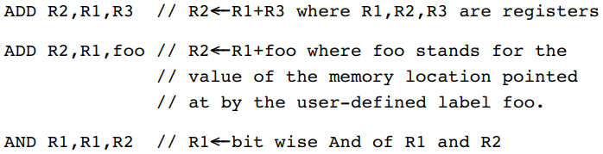
Instructions operations
2 types of commands: operations and access
Operations: arithmetic and boolean
Arithmetic
Eg. Set R2 to R1 + R3
1010001100011001 (this 16-bit computer has four 4-bit fields)
Boolean
Eg. Set R1 to the result of a bit wise And of R1 and R2

Slide 7
Instructions operations
2 types of commands: operations and access
Operations: arithmetic and boolean
Arithmetic
Eg. Set R2 to R1 + R3
1010001100011001 (this 16-bit computer has four 4-bit fields)
Boolean
Eg. Set R1 to the result of a bit wise And of R1 and R2

Slide 8
Instructions operations
2 types of commands: operations and access
Operations: arithmetic and boolean
Arithmetic
Eg. Set R2 to R1 + R3
1010001100011001 (this 16-bit computer has four 4-bit fields)
Boolean
Eg. Set R1 to the result of a bit wise And of R1 and R2

Slide 9
Instructions operations
2 types of commands: operations and access
Operations: arithmetic and boolean
Arithmetic
Eg. Set R2 to R1 + R3
1010001100011001 (this 16-bit computer has four 4-bit fields)
Boolean
Eg. Set R1 to the result of a bit wise And of R1 and R2
ADD R2, R1, R3

Slide 10
Instructions operations
2 types of commands: operations and access
Operations: arithmetic and boolean
Arithmetic
Eg. Set R2 to R1 + R3
1010001100011001 (this 16-bit computer has four 4-bit fields)
Boolean
Eg. Set R1 to the result of a bit wise And of R1 and R2
ADD R2, R1, R3

Slide 11
Instructions operations
2 types of commands: operations and access
Operations: arithmetic and boolean
Arithmetic
Eg. Set R2 to R1 + R3
1010001100011001 (this 16-bit computer has four 4-bit fields)
Boolean
Eg. Set R1 to the result of a bit wise And of R1 and R2
ADD R2, R1, R3

Slide 12
Instructions operations
2 types of commands: operations and access
Operations: arithmetic and boolean
Arithmetic
Eg. Set R2 to R1 + R3
1010001100011001 (this 16-bit computer has four 4-bit fields)
Boolean
Eg. Set R1 to the result of a bit wise And of R1 and R2
ADD R2, R1, R3

Slide 13

Instructions access
2 types of commands: operations and access
Access: loading and storing
3 addressing modes: direct, immediate, or indirect
Direct: express a specific address
Immediate: load constant
Indirect: specify memory location that holds the address you want (pointer)
Accessing memory is slow $→$ keep some registers close to the processor for high-speed local memory

Slide 14

Instructions access
2 types of commands: operations and access
Access: loading and storing
3 addressing modes: direct, immediate, or indirect
Direct: express a specific address
Immediate: load constant
Indirect: specify memory location that holds the address you want (pointer)
Accessing memory is slow $→$ keep some registers close to the processor for high-speed local memory

Slide 15
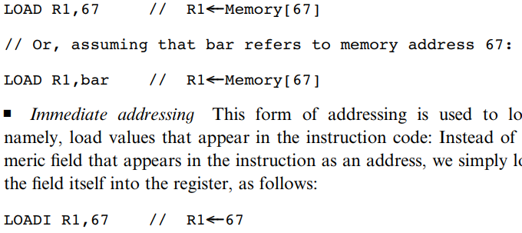

Instructions access
2 types of commands: operations and access
Access: loading and storing
3 addressing modes: direct, immediate, or indirect
Direct: express a specific address
Immediate: load constant
Indirect: specify memory location that holds the address you want (pointer)
Accessing memory is slow $→$ keep some registers close to the processor for high-speed local memory

Slide 16

Instructions access
2 types of commands: operations and access
Access: loading and storing
3 addressing modes: direct, immediate, or indirect
Direct: express a specific address
Immediate: load constant
Indirect: specify memory location that holds the address you want (pointer)
Accessing memory is slow $→$ keep some registers close to the processor for high-speed local memory

Slide 17
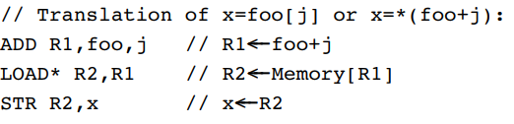

Instructions access
2 types of commands: operations and access
Access: loading and storing
3 addressing modes: direct, immediate, or indirect
Direct: express a specific address
Immediate: load constant
Indirect: specify memory location that holds the address you want (pointer)
Accessing memory is slow $→$ keep some registers close to the processor for high-speed local memory

Slide 18

Instructions access
2 types of commands: operations and access
Access: loading and storing
3 addressing modes: direct, immediate, or indirect
Direct: express a specific address
Immediate: load constant
Indirect: specify memory location that holds the address you want (pointer)
Accessing memory is slow ! $→$ keep some registers close to the processor for high-speed local memory

Slide 19

Instructions access
2 types of commands: operations and access
Access: loading and storing
3 addressing modes: direct, immediate, or indirect
Direct: express a specific address
Immediate: load constant
Indirect: specify memory location that holds the address you want (pointer)
Accessing memory is slow ! $→$ keep some registers close to the processor for high-speed local memory

Slide 20

Instructions access
2 types of commands: operations and access
Access: loading and storing
3 addressing modes: direct, immediate, or indirect
Direct: express a specific address
Immediate: load constant
Indirect: specify memory location that holds the address you want (pointer)
Accessing memory is slow ! $→$ keep some registers close to the processor for high-speed local memory

Slide 21
Instructions flow control
3 types of commands: operations and access (and flow control)
Flow control: repetition, conditional execution, subroutine calling, etc.
Repetition: jump back to beginning of loop
Conditional execution: if Boolean is True, follow the jump
Conditional JNG vs unconditional JMP
Subroutine calling: jump to the first command of another code segment

Slide 22
Instructions flow control
3 types of commands: operations and access (and flow control)
Flow control: repetition, conditional execution, subroutine calling, etc.
Repetition: jump back to beginning of loop
Conditional execution: if Boolean is True, follow the jump
Conditional JNG vs unconditional JMP
Subroutine calling: jump to the first command of another code segment

Slide 23
Instructions flow control
3 types of commands: operations and access (and flow control)
Flow control: repetition, conditional execution, subroutine calling, etc.
Repetition: jump back to beginning of loop
Conditional execution: if Boolean is True, follow the jump
Conditional JNG vs unconditional JMP
Subroutine calling: jump to the first command of another code segment

Slide 24
Instructions flow control
3 types of commands: operations and access (and flow control)
Flow control: repetition, conditional execution, subroutine calling, etc.
Repetition: jump back to beginning of loop
Conditional execution: if Boolean is True, follow the jump
Conditional JNG vs unconditional JMP
Subroutine calling: jump to the first command of another code segment

Slide 25
Instructions flow control
3 types of commands: operations and access (and flow control)
Flow control: repetition, conditional execution, subroutine calling, etc.
Repetition: jump back to beginning of loop
Conditional execution: if Boolean is True, follow the jump
Conditional JNG vs unconditional JMP
Subroutine calling: jump to the first command of another code segment

Slide 26
Instructions flow control
3 types of commands: operations and access (and flow control)
Flow control: repetition, conditional execution, subroutine calling, etc.
Repetition: jump back to beginning of loop
Conditional execution: if Boolean is True, follow the jump
Conditional JNG vs unconditional JMP
Subroutine calling: jump to the first command of another code segment

Slide 27
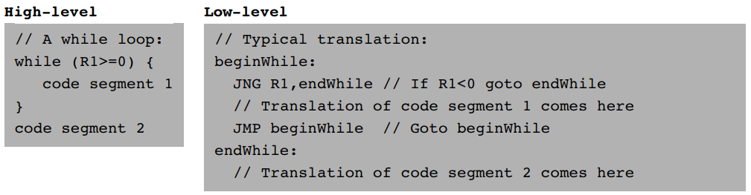
Instructions flow control
3 types of commands: operations and access (and flow control)
Flow control: repetition, conditional execution, subroutine calling, etc.
Repetition: jump back to beginning of loop
Conditional execution: if Boolean is True, follow the jump
Conditional JNG vs unconditional JMP
Subroutine calling: jump to the first command of another code segment

Slide 28
Instructions flow control
3 types of commands: operations and access (and flow control)
Flow control: repetition, conditional execution, subroutine calling, etc.
Repetition: jump back to beginning of loop
Conditional execution: if Boolean is True, follow the jump
Conditional JNG vs unconditional JMP
Subroutine calling: jump to the first command of another code segment

Slide 29
Instructions flow control
3 types of commands: operations and access (and flow control)
Flow control: repetition, conditional execution, subroutine calling, etc.
Repetition: jump back to beginning of loop
Conditional execution: if Boolean is True, follow the jump
Conditional JNG vs unconditional JMP
Subroutine calling: jump to the first command of another code segment

Slide 30
Instructions flow control
3 types of commands: operations and access (and flow control)
Flow control: repetition, conditional execution, subroutine calling, etc.
Repetition: jump back to beginning of loop
Conditional execution: if Boolean is True, follow the jump
Conditional JNG vs unconditional JMP
Subroutine calling: jump to the first command of another code segment

Slide 31
Instructions flow control
3 types of commands: operations and access (and flow control)
Flow control: repetition, conditional execution, subroutine calling, etc.
Repetition: jump back to beginning of loop
Conditional execution: if Boolean is True, follow the jump
Conditional JNG vs unconditional JMP
Subroutine calling: jump to the first command of another code segment

Slide 32
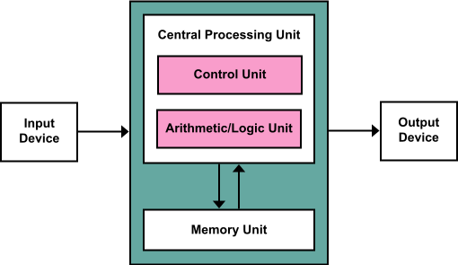
Hack
The Hack computer is a von Neumann platform
It is a 16-bit machine
Components
CPU
2 separate memory modules: instruction memory and data memory
Both memories are 16 bits wide
Both have a 15-bit address space
CPU can only execute programs in the instruction memory
The instruction memory is read-only: programs are loaded onto it (like a game cartridge/ROM chip)
2 I/O devices: a screen and a keyboard

Slide 33
Hack
The Hack computer is a von Neumann platform
It is a 16-bit machine
Components
CPU
2 separate memory modules: instruction memory and data memory
Both memories are 16 bits wide
Both have a 15-bit address space
CPU can only execute programs in the instruction memory
The instruction memory is read-only: programs are loaded onto it (like a game cartridge/ROM chip)
2 I/O devices: a screen and a keyboard

Slide 34
Hack
The Hack computer is a von Neumann platform
It is a 16-bit machine
Components
CPU
2 separate memory modules: instruction memory and data memory
Both memories are 16 bits wide
Both have a 15-bit address space
CPU can only execute programs in the instruction memory
The instruction memory is read-only: programs are loaded onto it (like a game cartridge/ROM chip)
2 I/O devices: a screen and a keyboard

Slide 35
Hack
The Hack computer is a von Neumann platform
It is a 16-bit machine
Components
CPU
2 separate memory modules: instruction memory and data memory
Both memories are 16 bits wide
Both have a 15-bit address space
CPU can only execute programs in the instruction memory
The instruction memory is read-only: programs are loaded onto it (like a game cartridge/ROM chip)
2 I/O devices: a screen and a keyboard

Slide 36
Hack
The Hack computer is a von Neumann platform
It is a 16-bit machine
Components
CPU
2 separate memory modules: instruction memory and data memory
Both memories are 16 bits wide
Both have a 15-bit address space
CPU can only execute programs in the instruction memory
The instruction memory is read-only: programs are loaded onto it (like a game cartridge/ROM chip)
2 I/O devices: a screen and a keyboard

Slide 37
Hack
The Hack computer is a von Neumann platform
It is a 16-bit machine
Components
CPU
2 separate memory modules: instruction memory and data memory
Both memories are 16 bits wide
Both have a 15-bit address space
CPU can only execute programs in the instruction memory
The instruction memory is read-only: programs are loaded onto it (like a game cartridge/ROM chip)
2 I/O devices: a screen and a keyboard

Slide 38
Hack
The Hack computer is a von Neumann platform
It is a 16-bit machine
Components
CPU
2 separate memory modules: instruction memory and data memory
Both memories are 16 bits wide
Both have a 15-bit address space
CPU can only execute programs in the instruction memory
The instruction memory is read-only: programs are loaded onto it (like a game cartridge/ROM chip)
2 I/O devices: a screen and a keyboard

Slide 39
Hack registers
Two 16-bit registers: A and D
Can be manipulated by arithmetic or boolean instructions
Eg. Arithmetic
Boolean
D only stores data values
A can be interpreted as a value or as an address (in the instruction memory or the data memory)
As an address in the data memory (Memory[A])
Instructions are 16 bits wide Cannot pack both an operation and address in one instruction A holds the address of M
Addresses are specified with 15 bits
Eg. To set D = Memory[516] – 1, first set A = 516 and then do D=M-1
As an address in the instruction memory (InstructionMemory[A])
Any jump always takes you to the address held by A
Eg. To fetch the instruction in InstructionMemory[35], set A = 35 and then use ‘goto’

Slide 40
Hack registers
Two 16-bit registers: A and D
Can be manipulated by arithmetic or boolean instructions
Eg. Arithmetic
Boolean
D only stores data values
A can be interpreted as a value or as an address (in the instruction memory or the data memory)
As an address in the data memory (Memory[A])
Instructions are 16 bits wide Cannot pack both an operation and address in one instruction A holds the address of M
Addresses are specified with 15 bits
Eg. To set D = Memory[516] – 1, first set A = 516 and then do D=M-1
As an address in the instruction memory (InstructionMemory[A])
Any jump always takes you to the address held by A
Eg. To fetch the instruction in InstructionMemory[35], set A = 35 and then use ‘goto’

Slide 41
Hack registers
Two 16-bit registers: A and D
Can be manipulated by arithmetic or boolean instructions
Eg. Arithmetic
Boolean
D only stores data values
A can be interpreted as a value or as an address (in the instruction memory or the data memory)
As an address in the data memory (Memory[A])
Instructions are 16 bits wide Cannot pack both an operation and address in one instruction A holds the address of M
Addresses are specified with 15 bits
Eg. To set D = Memory[516] – 1, first set A = 516 and then do D=M-1
As an address in the instruction memory (InstructionMemory[A])
Any jump always takes you to the address held by A
Eg. To fetch the instruction in InstructionMemory[35], set A = 35 and then use ‘goto’

Slide 42
Hack registers
Two 16-bit registers: A and D
Can be manipulated by arithmetic or boolean instructions
Eg. Arithmetic
Boolean
D only stores data values
A can be interpreted as a value or as an address (in the instruction memory or the data memory)
As an address in the data memory (Memory[A])
Instructions are 16 bits wide Cannot pack both an operation and address in one instruction A holds the address of M
Addresses are specified with 15 bits
Eg. To set D = Memory[516] – 1, first set A = 516 and then do D=M-1
As an address in the instruction memory (InstructionMemory[A])
Any jump always takes you to the address held by A
Eg. To fetch the instruction in InstructionMemory[35], set A = 35 and then use ‘goto’

Slide 43
Hack registers
Two 16-bit registers: A and D
Can be manipulated by arithmetic or boolean instructions
Eg. Arithmetic
Boolean
D only stores data values
A can be interpreted as a value or as an address (in the instruction memory or the data memory)
As an address in the data memory (Memory[A])
Instructions are 16 bits wide Cannot pack both an operation and address in one instruction A holds the address of M
Addresses are specified with 15 bits
Eg. To set D = Memory[516] – 1, first set A = 516 and then do D=M-1
As an address in the instruction memory (InstructionMemory[A])
Any jump always takes you to the address held by A
Eg. To fetch the instruction in InstructionMemory[35], set A = 35 and then use ‘goto’

Slide 44
Hack registers
Two 16-bit registers: A and D
Can be manipulated by arithmetic or boolean instructions
Eg. Arithmetic
Boolean
D only stores data values
A can be interpreted as a value or as an address (in the instruction memory or the data memory)
As an address in the data memory (Memory[A])
Instructions are 16 bits wide Cannot pack both an operation and address in one instruction A holds the address of M
Addresses are specified with 15 bits
Eg. To set D = Memory[516] – 1, first set A = 516 and then do D=M-1
As an address in the instruction memory (InstructionMemory[A])
Any jump always takes you to the address held by A
Eg. To fetch the instruction in InstructionMemory[35], set A = 35 and then use ‘goto’

Slide 45
Hack registers
Two 16-bit registers: A and D
Can be manipulated by arithmetic or boolean instructions
Eg. Arithmetic
Boolean
D only stores data values
A can be interpreted as a value or as an address (in the instruction memory or the data memory)
As an address in the data memory (Memory[])
Instructions are 16 bits wide Cannot pack both an operation and address in one instruction A holds the address of M
Addresses are specified with 15 bits
Eg. To set D = Memory[516] – 1, first set A = 516 and then do D=M-1
As an address in the instruction memory (InstructionMemory[])
Any jump always takes you to the address held by A
Eg. To fetch the instruction in InstructionMemory[35], set A = 35 and then use ‘goto’

Slide 46
Hack registers
Two 16-bit registers: A and D
Can be manipulated by arithmetic or boolean instructions
Eg. Arithmetic
Boolean
D only stores data values
A can be interpreted as a value or as an address (in the instruction memory or the data memory)
As an address in the data memory (Memory[])
Instructions are 16 bits wide Cannot pack both an operation and address in one instruction A holds the address of M
Addresses are specified with 15 bits
Eg. To set D = Memory[516] – 1, first set A = 516 and then do D=M-1
As an address in the instruction memory (InstructionMemory[])
Any jump always takes you to the address held by A
Eg. To fetch the instruction in InstructionMemory[35], set A = 35 and then use ‘goto’

Slide 47
Hack registers
Two 16-bit registers: A and D
Can be manipulated by arithmetic or boolean instructions
Eg. Arithmetic
Boolean
D only stores data values
A can be interpreted as a value or as an address (in the instruction memory or the data memory)
As an address in the data memory (Memory[])
Instructions are 16 bits wide Cannot pack both an operation and address in one instruction A holds the address of M
Addresses are specified with 15 bits
Eg. To set D = Memory[516] – 1, first set A = 516 and then do D=M-1
As an address in the instruction memory (InstructionMemory[])
Any jump always takes you to the address held by A
Eg. To fetch the instruction in InstructionMemory[35], set A = 35 and then use ‘goto’

Slide 48
Hack registers
Two 16-bit registers: A and D
Can be manipulated by arithmetic or boolean instructions
Eg. Arithmetic
Boolean
D only stores data values
A can be interpreted as a value or as an address (in the instruction memory or the data memory)
As an address in the data memory (Memory[])
Instructions are 16 bits wide A holds the address of M
Addresses are specified with 15 bits
Eg. To set D = Memory[516] – 1, first set A = 516 and then do D=M-1
As an address in the instruction memory (InstructionMemory[])
Any jump always takes you to the address held by A
Eg. To fetch the instruction in InstructionMemory[35], set A = 35 and then use ‘goto’
cannot pack both an operation and address in one instruction

Slide 49
Hack registers
Two 16-bit registers: A and D
Can be manipulated by arithmetic or boolean instructions
Eg. Arithmetic
Boolean
D only stores data values
A can be interpreted as a value or as an address (in the instruction memory or the data memory)
As an address in the data memory (Memory[])
Instructions are 16 bits wide
Addresses are specified with 15 bits
Eg. To set D = Memory[516] – 1, first set A = 516 and then do D=M-1
As an address in the instruction memory (InstructionMemory[])
Any jump always takes you to the address held by A
Eg. To fetch the instruction in InstructionMemory[35], set A = 35 and then use ‘goto’
cannot pack both an operation and address in one instruction A holds the address of M

Slide 50
Hack registers
Two 16-bit registers: A and D
Can be manipulated by arithmetic or boolean instructions
Eg. Arithmetic
Boolean
D only stores data values
A can be interpreted as a value or as an address (in the instruction memory or the data memory)
As an address in the data memory (Memory[])
Instructions are 16 bits wide
Addresses are specified with 15 bits
Eg. To set D = Memory[516] – 1, first set A = 516 and then do D=M-1
As an address in the instruction memory (InstructionMemory[])
Any jump always takes you to the address held by A
Eg. To fetch the instruction in InstructionMemory[35], set A = 35 and then use ‘goto’
cannot pack both an operation and address in one instruction A holds the address of M

Slide 51
Hack registers
Two 16-bit registers: A and D
Can be manipulated by arithmetic or boolean instructions
Eg. Arithmetic
Boolean
D only stores data values
A can be interpreted as a value or as an address (in the instruction memory or the data memory)
As an address in the data memory (Memory[])
Instructions are 16 bits wide
Addresses are specified with 15 bits
Eg. To set D = Memory[516] – 1, first set A = 516 and then do D=M-1
As an address in the instruction memory (InstructionMemory[])
Any jump always takes you to the address held by A
Eg. To fetch the instruction in InstructionMemory[35], set A = 35 and then use ‘goto’
cannot pack both an operation and address in one instruction A holds the address of M

Slide 52
Hack registers
Two 16-bit registers: A and D
Can be manipulated by arithmetic or boolean instructions
Eg. Arithmetic
Boolean
D only stores data values
A can be interpreted as a value or as an address (in the instruction memory or the data memory)
As an address in the data memory (Memory[])
Instructions are 16 bits wide
Addresses are specified with 15 bits
Eg. To set D = Memory[516] – 1, first set A = 516 and then do D=M-1
As an address in the instruction memory (InstructionMemory[])
Any jump always takes you to the address held by A
Eg. To fetch the instruction in InstructionMemory[35], set A = 35 and then use ‘goto’
cannot pack both an operation and address in one instruction A holds the address of M

Slide 53
Hack registers
Two 16-bit registers: A and D
Can be manipulated by arithmetic or boolean instructions
Eg. Arithmetic
Boolean
D only stores data values
A can be interpreted as a value or as an address (in the instruction memory or the data memory)
As an address in the data memory (Memory[])
Instructions are 16 bits wide
Addresses are specified with 15 bits
Eg. To set D = Memory[516] – 1, first set A = 516 and then do D=M-1
As an address in the instruction memory (InstructionMemory[])
Any jump always takes you to the address held by A
Eg. To fetch the instruction in InstructionMemory[35], set A = 35 and then use ‘goto’
cannot pack both an operation and address in one instruction A holds the address of M

Slide 54
Hack registers
Two 16-bit registers: A and D
Can be manipulated by arithmetic or boolean instructions
Eg. Arithmetic
Boolean
D only stores data values
A can be interpreted as a value or as an address (in the instruction memory or the data memory)
As an address in the data memory (Memory[])
Instructions are 16 bits wide
Addresses are specified with 15 bits
Eg. To set D = Memory[516] – 1, first set A = 516 and then do D=M-1
As an address in the instruction memory (InstructionMemory[])
Any jump always takes you to the address held by A
Eg. To fetch the instruction in InstructionMemory[35], set A = 35 and then use ‘goto’
cannot pack both an operation and address in one instruction A holds the address of M

Slide 55
Hack registers
Two 16-bit registers: A and D
Can be manipulated by arithmetic or boolean instructions
Eg. Arithmetic
Boolean
D only stores data values
A can be interpreted as a value or as an address (in the instruction memory or the data memory)
As an address in the data memory (Memory[])
Instructions are 16 bits wide
Addresses are specified with 15 bits
Eg. To set D = Memory[516] – 1, first set A = 516 and then do D=M-1
As an address in the instruction memory (InstructionMemory[])
Any jump always takes you to the address held by A
Eg. To fetch the instruction in InstructionMemory[35], set A = 35 and then use ‘goto’
cannot pack both an operation and address in one instruction A holds the address of M

Slide 56
Hack registers
Two 16-bit registers: A and D
Can be manipulated by arithmetic or boolean instructions
Eg. Arithmetic
Boolean
D only stores data values
A can be interpreted as a value or as an address (in the instruction memory or the data memory)
As an address in the data memory (Memory[])
Instructions are 16 bits wide
Addresses are specified with 15 bits
Eg. To set D = Memory[516] – 1, first set A = 516 and then do D=M-1
As an address in the instruction memory (InstructionMemory[])
Any jump always takes you to the address held by A
Eg. To fetch the instruction in InstructionMemory[35], set A = 35 and then use ‘goto’
cannot pack both an operation and address in one instruction A holds the address of M

Slide 57
Hack registers
Two 16-bit registers: A and D
Can be manipulated by arithmetic or boolean instructions
Eg. Arithmetic
Boolean
D only stores data values
A can be interpreted as a value or as an address (in the instruction memory or the data memory)
As an address in the data memory (Memory[])
Instructions are 16 bits wide
Addresses are specified with 15 bits
Eg. To set D = Memory[516] – 1, first set A = 516 and then do D=M-1
As an address in the instruction memory (InstructionMemory[])
Any jump always takes you to the address held by A
Eg. To fetch the instruction in InstructionMemory[35], set A = 35 and then use ‘goto’
cannot pack both an operation and address in one instruction A holds the address of M

Slide 58
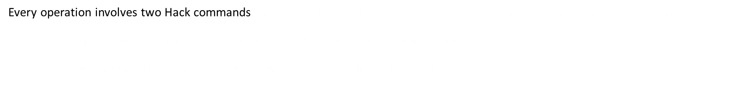
Hack two instructions
Every operation involves two Hack commands: an address instruction (A-instruction) and a compute instruction (C-instruction)
A-instruction: sets A register to a 15-bit value $→$ selects the address on which to operate
C-instruction: specifies the desired operation, where to store the result, and where to go next
Eg.
if Memory[3]=5 then goto 100
else goto 200:
@3 // A=3
D=M // D=Memory[A]=M[3]
@5 // A=5
D=D-A // D=D-5
@100 // A=100 is address to jump to
D;JEQ // If D=0 goto 100
@200 // A=200 is address to jump to
0;JMP // Goto 200 (0 is arbitrary)

Slide 59
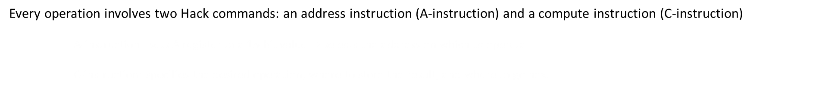
Hack two instructions
Every operation involves two Hack commands: an address instruction (A-instruction) and a compute instruction (C-instruction)
A-instruction: sets A register to a 15-bit value $→$ selects the address on which to operate
C-instruction: specifies the desired operation, where to store the result, and where to go next
Eg.
if Memory[3]=5 then goto 100
else goto 200:
@3 // A=3
D=M // D=Memory[A]=M[3]
@5 // A=5
D=D-A // D=D-5
@100 // A=100 is address to jump to
D;JEQ // If D=0 goto 100
@200 // A=200 is address to jump to
0;JMP // Goto 200 (0 is arbitrary)

Slide 60
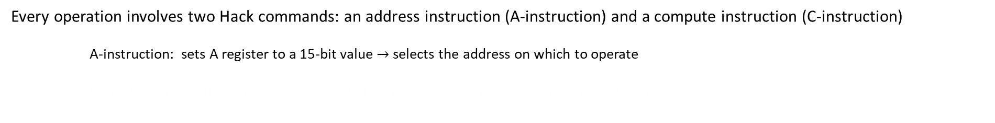
Hack two instructions
Every operation involves two Hack commands: an address instruction (A-instruction) and a compute instruction (C-instruction)
A-instruction: sets A register to a 15-bit value $→$ selects the address on which to operate
C-instruction: specifies the desired operation, where to store the result, and where to go next
Eg.
if Memory[3]=5 then goto 100
else goto 200:
@3 // A=3
D=M // D=Memory[A]=M[3]
@5 // A=5
D=D-A // D=D-5
@100 // A=100 is address to jump to
D;JEQ // If D=0 goto 100
@200 // A=200 is address to jump to
0;JMP // Goto 200 (0 is arbitrary)

Slide 61
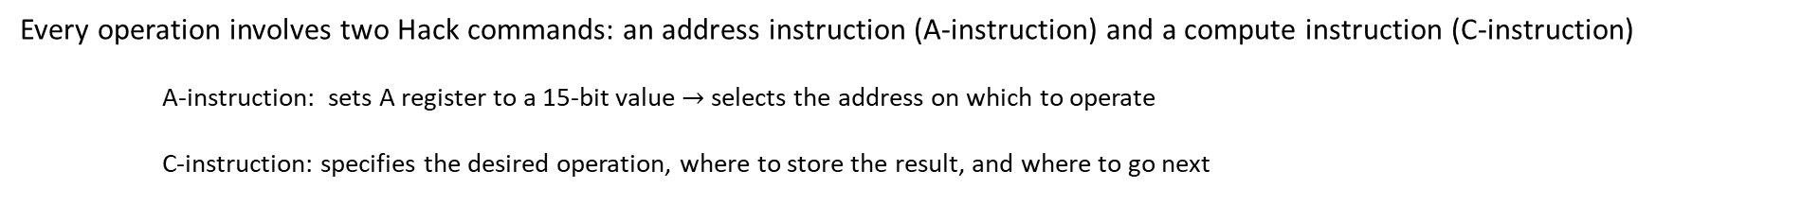
Hack two instructions
Every operation involves two Hack commands: an address instruction (A-instruction) and a compute instruction (C-instruction)
A-instruction: sets A register to a 15-bit value $→$ selects the address on which to operate
C-instruction: specifies the desired operation, where to store the result, and where to go next
Eg.
if Memory[3]=5 then goto 100
else goto 200:
@3 // A=3
D=M // D=Memory[A]=M[3]
@5 // A=5
D=D-A // D=D-5
@100 // A=100 is address to jump to
D;JEQ // If D=0 goto 100
@200 // A=200 is address to jump to
0;JMP // Goto 200 (0 is arbitrary)

Slide 62

Hack A-instruction
Every operation involves two Hack commands: an address instruction (A-instruction) and a compute instruction (C-instruction)
A-instruction: sets A register to a 15-bit value $→$ selects the address on which to operate
@value // Where value is either a non-negative decimal number
// or a symbol referring to such number.
Eg. @5 // store the binary representation of 5 in register A register A = 5 = 0000000000000101
3 purposes
Only way to enter a constant into the computer
Sets the register to be manipulated by the C-instruction
Sets the jump destination

Slide 63

Hack A-instruction
Every operation involves two Hack commands: an address instruction (A-instruction) and a compute instruction (C-instruction)
A-instruction: sets A register to a 15-bit value $→$ selects the address on which to operate
@value // Where value is either a non-negative decimal number
// or a symbol referring to such number.
Eg. @5 // store the binary representation of 5 in register A register A = 5 = 0000000000000101
3 purposes
Only way to enter a constant into the computer
Sets the register to be manipulated by the C-instruction
Sets the jump destination

Slide 64

Hack A-instruction
Every operation involves two Hack commands: an address instruction (A-instruction) and a compute instruction (C-instruction)
A-instruction: sets A register to a 15-bit value $→$ selects the address on which to operate
@value // Where value is either a non-negative decimal number
// or a symbol referring to such number.
Eg. @5 // store the binary representation of 5 in register A register A = 5 = 0000000000000101
3 purposes
Only way to enter a constant into the computer
Sets the register to be manipulated by the C-instruction
Sets the jump destination

Slide 65

Hack A-instruction
Every operation involves two Hack commands: an address instruction (A-instruction) and a compute instruction (C-instruction)
A-instruction: sets A register to a 15-bit value $→$ selects the address on which to operate
@value // Where value is either a non-negative decimal number
// or a symbol referring to such number.
Eg. @5 // store the binary representation of 5 in register A register A = 5 = 0000000000000101
3 purposes
Only way to enter a constant into the computer
Sets the register to be manipulated by the C-instruction
Sets the jump destination

Slide 66
Hack A-instruction
Every operation involves two Hack commands: an address instruction (A-instruction) and a compute instruction (C-instruction)
A-instruction: sets A register to a 15-bit value $→$ selects the address on which to operate
@value // Where value is either a non-negative decimal number
// or a symbol referring to such number.
Eg. @5 // store the binary representation of 5 in register A register A = 5 = 0000000000000101
3 purposes
Only way to enter a constant into the computer
Sets the register to be manipulated by the C-instruction
Sets the jump destination
indicates A-instruction

Slide 67
Hack A-instruction
Every operation involves two Hack commands: an address instruction (A-instruction) and a compute instruction (C-instruction)
A-instruction: sets A register to a 15-bit value $→$ selects the address on which to operate
@value // Where value is either a non-negative decimal number
// or a symbol referring to such number.
Eg. @5 // store the binary representation of 5 in register A register A = 5 = 0000000000000101
3 purposes
Only way to enter a constant into the computer
Sets the register to be manipulated by the C-instruction
Sets the jump destination
value in binary
indicates A-instruction

Slide 68

Hack A-instruction
Every operation involves two Hack commands: an address instruction (A-instruction) and a compute instruction (C-instruction)
A-instruction: sets A register to a 15-bit value $→$ selects the address on which to operate
@value // Where value is either a non-negative decimal number
// or a symbol referring to such number.
Eg. @5 // store the binary representation of 5 in register A register A = 5 = 0000000000000101
3 purposes
Only way to enter a constant into the computer
Sets the register to be manipulated by the C-instruction
Sets the jump destination
value in binary
indicates A-instruction

Slide 69

Hack A-instruction
Every operation involves two Hack commands: an address instruction (A-instruction) and a compute instruction (C-instruction)
A-instruction: sets A register to a 15-bit value $→$ selects the address on which to operate
@value // Where value is either a non-negative decimal number
// or a symbol referring to such number.
Eg. @5 // store the binary representation of 5 in register A register A = 5 = 0000000000000101
3 purposes
Only way to enter a constant into the computer
Sets the register to be manipulated by the C-instruction
Sets the jump destination
value in binary
indicates A-instruction

Slide 70

Hack A-instruction
Every operation involves two Hack commands: an address instruction (A-instruction) and a compute instruction (C-instruction)
A-instruction: sets A register to a 15-bit value $→$ selects the address on which to operate
@value // Where value is either a non-negative decimal number
// or a symbol referring to such number.
Eg. @5 // store the binary representation of 5 in register A register A = 5 = 0000000000000101
3 purposes
Only way to enter a constant into the computer
Sets the register to be manipulated by the C-instruction
Sets the jump destination
value in binary
indicates A-instruction

Slide 71

Hack A-instruction
Every operation involves two Hack commands: an address instruction (A-instruction) and a compute instruction (C-instruction)
A-instruction: sets A register to a 15-bit value $→$ selects the address on which to operate
@value // Where value is either a non-negative decimal number
// or a symbol referring to such number.
Eg. @5 // store the binary representation of 5 in register A register A = 5 = 0000000000000101
3 purposes
Only way to enter a constant into the computer
Sets the register to be manipulated by the C-instruction
Sets the jump destination
value in binary
indicates A-instruction

Slide 72

Hack A-instruction
Every operation involves two Hack commands: an address instruction (A-instruction) and a compute instruction (C-instruction)
A-instruction: sets A register to a 15-bit value $→$ selects the address on which to operate
@value // Where value is either a non-negative decimal number
// or a symbol referring to such number.
Eg. @5 // store the binary representation of 5 in register A register A = 5 = 0000000000000101
3 purposes
Only way to enter a constant into the computer
Sets the register to be manipulated by the C-instruction
Sets the jump destination
value in binary
indicates A-instruction

Slide 73
Hack C-instruction
Every operation involves two Hack commands: an address instruction (A-instruction) and a compute instruction (C-instruction)
C-instruction: specifies the desired operation, where to store the result, and where to go next
dest=comp;jump // Either the dest or jump fields may be empty.
// If dest is empty, the ‘‘=’’ is omitted;
// If jump is empty, the ‘‘;’’ is omitted.
Eg.
comp dest jump

Slide 74
Hack C-instruction
Every operation involves two Hack commands: an address instruction (A-instruction) and a compute instruction (C-instruction)
C-instruction: specifies the desired operation, where to store the result, and where to go next
dest=comp;jump // Either the dest or jump fields may be empty.
// If dest is empty, the ‘‘=’’ is omitted;
// If jump is empty, the ‘‘;’’ is omitted.
Eg.
comp dest jump

Slide 75

Hack C-instruction
Every operation involves two Hack commands: an address instruction (A-instruction) and a compute instruction (C-instruction)
C-instruction: specifies the desired operation, where to store the result, and where to go next
dest=comp;jump // Either the dest or jump fields may be empty.
// If dest is empty, the ‘‘=’’ is omitted;
// If jump is empty, the ‘‘;’’ is omitted.
Eg.
comp dest jump

Slide 76
Hack C-instruction
Every operation involves two Hack commands: an address instruction (A-instruction) and a compute instruction (C-instruction)
C-instruction: specifies the desired operation, where to store the result, and where to go next
dest=comp;jump // Either the dest or jump fields may be empty.
// If dest is empty, the ‘‘=’’ is omitted;
// If jump is empty, the ‘‘;’’ is omitted.
Eg.
comp dest jump
indicates C-instruction
unused

Slide 77
Hack C-instruction
Every operation involves two Hack commands: an address instruction (A-instruction) and a compute instruction (C-instruction)
C-instruction: specifies the desired operation, where to store the result, and where to go next
dest=comp;jump // Either the dest or jump fields may be empty.
// If dest is empty, the ‘‘=’’ is omitted;
// If jump is empty, the ‘‘;’’ is omitted.
Eg.
comp dest jump
indicates C-instruction
unused

Slide 78
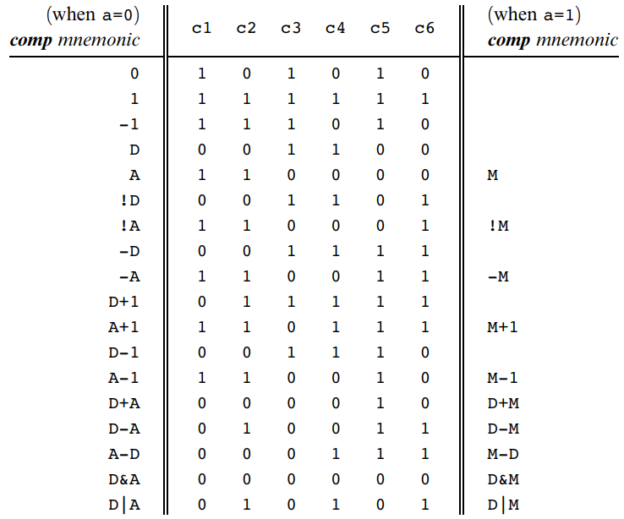
Hack C-instruction
Every operation involves two Hack commands: an address instruction (A-instruction) and a compute instruction (C-instruction)
C-instruction: specifies the desired operation, where to store the result, and where to go next
dest=comp;jump // Either the dest or jump fields may be empty.
// If dest is empty, the ‘‘=’’ is omitted;
// If jump is empty, the ‘‘;’’ is omitted.
Eg.
comp dest jump
indicates C-instruction
unused

Slide 79
Hack C-instruction
Every operation involves two Hack commands: an address instruction (A-instruction) and a compute instruction (C-instruction)
C-instruction: specifies the desired operation, where to store the result, and where to go next
dest=comp;jump // Either the dest or jump fields may be empty.
// If dest is empty, the ‘‘=’’ is omitted;
// If jump is empty, the ‘‘;’’ is omitted.
Eg.
comp dest jump
indicates C-instruction
unused
compute w/ A or M

Slide 80
Hack C-instruction
Every operation involves two Hack commands: an address instruction (A-instruction) and a compute instruction (C-instruction)
C-instruction: specifies the desired operation, where to store the result, and where to go next
dest=comp;jump // Either the dest or jump fields may be empty.
// If dest is empty, the ‘‘=’’ is omitted;
// If jump is empty, the ‘‘;’’ is omitted.
Eg.
comp dest jump
indicates C-instruction
operation to compute
unused
compute w/ A or M
D-1: 1110 0011 1000 0000
D|M: 1111 0101 0100 0000
constant 1: 1110 1110 1000 0000

Slide 81
Hack C-instruction
Every operation involves two Hack commands: an address instruction (A-instruction) and a compute instruction (C-instruction)
C-instruction: specifies the desired operation, where to store the result, and where to go next
dest=comp;jump // Either the dest or jump fields may be empty.
// If dest is empty, the ‘‘=’’ is omitted;
// If jump is empty, the ‘‘;’’ is omitted.
Eg.
comp dest jump
indicates C-instruction
operation to compute
unused
compute w/ A or M
D-1: 1110 0011 1000 0000
D|M: 1111 0101 0100 0000
constant 1: 1110 1110 1000 0000

Slide 82
Hack C-instruction
Every operation involves two Hack commands: an address instruction (A-instruction) and a compute instruction (C-instruction)
C-instruction: specifies the desired operation, where to store the result, and where to go next
dest=comp;jump // Either the dest or jump fields may be empty.
// If dest is empty, the ‘‘=’’ is omitted;
// If jump is empty, the ‘‘;’’ is omitted.
Eg.
comp dest jump
indicates C-instruction
operation to compute
unused
compute w/ A or M
D-1: 1110 0011 1000 0000
D|M: 1111 0101 0100 0000
constant 1: 1110 1110 1000 0000

Slide 83
Hack C-instruction
Every operation involves two Hack commands: an address instruction (A-instruction) and a compute instruction (C-instruction)
C-instruction: specifies the desired operation, where to store the result, and where to go next
dest=comp;jump // Either the dest or jump fields may be empty.
// If dest is empty, the ‘‘=’’ is omitted;
// If jump is empty, the ‘‘;’’ is omitted.
Eg.
comp dest jump
indicates C-instruction
operation to compute
unused
compute w/ A or M
D-1: 1110 0011 1000 0000
D|M: 1111 0101 0100 0000
constant 1: 1110 1111 1100 0000

Slide 84
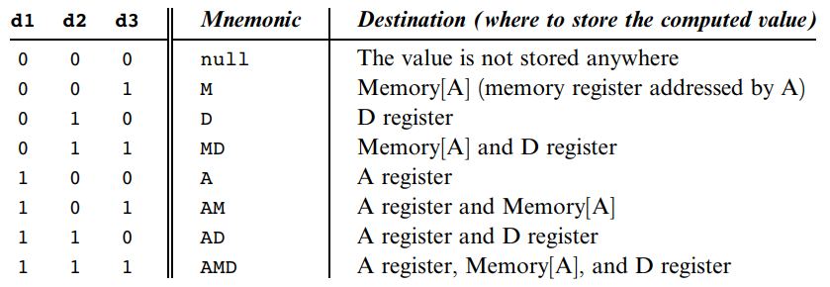
Hack C-instruction
Every operation involves two Hack commands: an address instruction (A-instruction) and a compute instruction (C-instruction)
C-instruction: specifies the desired operation, where to store the result, and where to go next
dest=comp;jump // Either the dest or jump fields may be empty.
// If dest is empty, the ‘‘=’’ is omitted;
// If jump is empty, the ‘‘;’’ is omitted.
Eg.
comp dest jump
indicates C-instruction
operation to compute
unused
compute w/ A or M
D-1: 1110 0011 1000 0000
D|M: 1111 0101 0100 0000
constant 1: 1110 1110 1000 0000

Slide 85
Hack C-instruction
Every operation involves two Hack commands: an address instruction (A-instruction) and a compute instruction (C-instruction)
C-instruction: specifies the desired operation, where to store the result, and where to go next
dest=comp;jump // Either the dest or jump fields may be empty.
// If dest is empty, the ‘‘=’’ is omitted;
// If jump is empty, the ‘‘;’’ is omitted.
Eg.
comp dest jump
indicates C-instruction
operation to compute
store in
A,D, or M
unused
compute w/ A or M
D-1: 1110 0011 1000 0000
D|M: 1111 0101 0100 0000
constant 1: 1110 1110 1000 0000

Slide 86
Hack C-instruction
Every operation involves two Hack commands: an address instruction (A-instruction) and a compute instruction (C-instruction)
C-instruction: specifies the desired operation, where to store the result, and where to go next
dest=comp;jump // Either the dest or jump fields may be empty.
// If dest is empty, the ‘‘=’’ is omitted;
// If jump is empty, the ‘‘;’’ is omitted.
Eg.
comp dest jump
indicates C-instruction
operation to compute
store in
A,D, or M
unused
compute w/ A or M
D-1: 1110 0011 1000 0000
D|M: 1111 0101 0100 0000
constant 1: 1110 1110 1000 0000
compute Memory[7] + 1 and store in D:
0000 0000 0000 0111 // @7 so A = 7 and M[A] = M[7]
1111 1101 1101 1000 // MD=M+1 so computes M+1
// and stores in both M and D

Slide 87
Hack C-instruction
Every operation involves two Hack commands: an address instruction (A-instruction) and a compute instruction (C-instruction)
C-instruction: specifies the desired operation, where to store the result, and where to go next
dest=comp;jump // Either the dest or jump fields may be empty.
// If dest is empty, the ‘‘=’’ is omitted;
// If jump is empty, the ‘‘;’’ is omitted.
Eg.
comp dest jump
indicates C-instruction
operation to compute
store in
A,D, or M
unused
compute w/ A or M
D-1: 1110 0011 1000 0000
D|M: 1111 0101 0100 0000
constant 1: 1110 1110 1000 0000
compute Memory[7] + 1 and store in D:
0000 0000 0000 0111 // @7 so A = 7 and M[A] = M[7]
1111 1101 1101 1000 // MD=M+1 so computes M+1
// and stores in both M and D

Slide 88
Hack C-instruction
Every operation involves two Hack commands: an address instruction (A-instruction) and a compute instruction (C-instruction)
C-instruction: specifies the desired operation, where to store the result, and where to go next
dest=comp;jump // Either the dest or jump fields may be empty.
// If dest is empty, the ‘‘=’’ is omitted;
// If jump is empty, the ‘‘;’’ is omitted.
Eg.
comp dest jump
indicates C-instruction
operation to compute
store in
A,D, or M
unused
compute w/ A or M
D-1: 1110 0011 1000 0000
D|M: 1111 0101 0100 0000
constant 1: 1110 1110 1000 0000
compute Memory[7] + 1 and store in D:
0000 0000 0000 0111 // @7 so A = 7 and M[A] = M[7]
1111 1101 1101 1000 // MD=M+1 so computes M+1
// and stores in both M and D

Slide 89
Hack C-instruction
Every operation involves two Hack commands: an address instruction (A-instruction) and a compute instruction (C-instruction)
C-instruction: specifies the desired operation, where to store the result, and where to go next
dest=comp;jump // Either the dest or jump fields may be empty.
// If dest is empty, the ‘‘=’’ is omitted;
// If jump is empty, the ‘‘;’’ is omitted.
Eg.
comp dest jump
indicates C-instruction
operation to compute
store in
A,D, or M
unused
compute w/ A or M
D-1: 1110 0011 1000 0000
D|M: 1111 0101 0100 0000
constant 1: 1110 1110 1000 0000
compute Memory[7] + 1 and store in D:
0000 0000 0000 0111 // @7 so A = 7 and M[A] = M[7]
1111 1101 1101 1000 // MD=M+1 so computes M+1
// and stores in both M and D

Slide 90
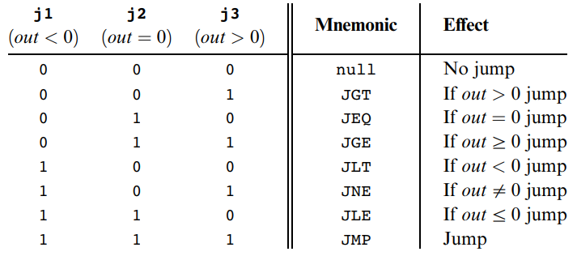
Hack C-instruction
Every operation involves two Hack commands: an address instruction (A-instruction) and a compute instruction (C-instruction)
C-instruction: specifies the desired operation, where to store the result, and where to go next
dest=comp;jump // Either the dest or jump fields may be empty.
// If dest is empty, the ‘‘=’’ is omitted;
// If jump is empty, the ‘‘;’’ is omitted.
Eg.
comp dest jump
indicates C-instruction
operation to compute
store in
A,D, or M
where to jump to
unused
compute w/ A or M
D-1: 1110 0011 1000 0000
D|M: 1111 0101 0100 0000
constant 1: 1110 1110 1000 0000
compute Memory[7] + 1 and store in D:
0000 0000 0000 0111 // @7 so A = 7 and M[A] = M[7]
1111 1101 1101 1000 // MD=M+1 so computes M+1
// and stores in both M and D

Slide 91
Hack C-instruction
Every operation involves two Hack commands: an address instruction (A-instruction) and a compute instruction (C-instruction)
C-instruction: specifies the desired operation, where to store the result, and where to go next
dest=comp;jump // Either the dest or jump fields may be empty.
// If dest is empty, the ‘‘=’’ is omitted;
// If jump is empty, the ‘‘;’’ is omitted.
Eg.
comp dest jump
indicates C-instruction
operation to compute
store in
A,D, or M
where to jump to
unused
compute w/ A or M
D-1: 1110 0011 1000 0000
D|M: 1111 0101 0100 0000
constant 1: 1110 1110 1000 0000
compute Memory[7] + 1 and store in D:
0000 0000 0000 0111 // @7 so A = 7 and M[A] = M[7]
1111 1101 1101 1000 // MD=M+1 so computes M+1
// and stores in both M and D
if Memory[3]=5 then goto 100
else goto 200:
@3 // A=3
D=M // D=Memory[A]=M[3]
@5 // A=5
D=D-A // D=D-5
@100 // A=100 is address to jump to
D;JEQ // If D=0 goto 100
@200 // A=200 is address to jump to
0;JMP // Goto 200 (0 is arbitrary)

Slide 92
Hack C-instruction
Every operation involves two Hack commands: an address instruction (A-instruction) and a compute instruction (C-instruction)
C-instruction: specifies the desired operation, where to store the result, and where to go next
dest=comp;jump // Either the dest or jump fields may be empty.
// If dest is empty, the ‘‘=’’ is omitted;
// If jump is empty, the ‘‘;’’ is omitted.
Eg.
comp dest jump
indicates C-instruction
operation to compute
store in
A,D, or M
where to jump to
unused
compute w/ A or M
D-1: 1110 0011 1000 0000
D|M: 1111 0101 0100 0000
constant 1: 1110 1110 1000 0000
compute Memory[7] + 1 and store in D:
0000 0000 0000 0111 // @7 so A = 7 and M[A] = M[7]
1111 1101 1101 1000 // MD=M+1 so computes M+1
// and stores in both M and D
if Memory[3]=5 then goto 100
else goto 200:
@3 // A=3
D=M // D=Memory[A]=M[3]
@5 // A=5
D=D-A // D=D-5
@100 // A=100 is address to jump to
D;JEQ // If D=0 goto 100
@200 // A=200 is address to jump to
0;JMP // Goto 200 (0 is arbitrary)

Slide 93
Hack C-instruction
Every operation involves two Hack commands: an address instruction (A-instruction) and a compute instruction (C-instruction)
C-instruction: specifies the desired operation, where to store the result, and where to go next
dest=comp;jump // Either the dest or jump fields may be empty.
// If dest is empty, the ‘‘=’’ is omitted;
// If jump is empty, the ‘‘;’’ is omitted.
Eg.
comp dest jump
indicates C-instruction
operation to compute
store in
A,D, or M
where to jump to
unused
compute w/ A or M
D-1: 1110 0011 1000 0000
D|M: 1111 0101 0100 0000
constant 1: 1110 1110 1000 0000
compute Memory[7] + 1 and store in D:
0000 0000 0000 0111 // @7 so A = 7 and M[A] = M[7]
1111 1101 1101 1000 // MD=M+1 so computes M+1
// and stores in both M and D
if Memory[3]=5 then goto 100
else goto 200:
@3 // A=3
D=M // D=Memory[A]=M[3]
@5 // A=5
D=D-A // D=D-5
@100 // A=100 is address to jump to
D;JEQ // If D=0 goto 100
@200 // A=200 is address to jump to
0;JMP // Goto 200 (0 is arbitrary)

Slide 94
Hack C-instruction
Every operation involves two Hack commands: an address instruction (A-instruction) and a compute instruction (C-instruction)
C-instruction: specifies the desired operation, where to store the result, and where to go next
dest=comp;jump // Either the dest or jump fields may be empty.
// If dest is empty, the ‘‘=’’ is omitted;
// If jump is empty, the ‘‘;’’ is omitted.
Eg.
comp dest jump
indicates C-instruction
operation to compute
store in
A,D, or M
where to jump to
unused
compute w/ A or M
D-1: 1110 0011 1000 0000
D|M: 1111 0101 0100 0000
constant 1: 1110 1110 1000 0000
compute Memory[7] + 1 and store in D:
0000 0000 0000 0111 // @7 so A = 7 and M[A] = M[7]
1111 1101 1101 1000 // MD=M+1 so computes M+1
// and stores in both M and D
if Memory[3]=5 then goto 100
else goto 200:
@3 // A=3
D=M // D=Memory[A]=M[3]
@5 // A=5
D=D-A // D=D-5
@100 // A=100 is address to jump to
D;JEQ // If D=0 goto 100
@200 // A=200 is address to jump to
0;JMP // Goto 200 (0 is arbitrary)

Slide 95
Hack symbols
R0 SP address 0 | R1 LCL address 1 | R2 ARG address 2 | R3 THIS address 3
R4 THAT address 4 | R5 address 5 | R6 address 6 | R7 address 7
R8 address 8 | R9 address 9 | R10 address 10 | R11 address 11
R12 address 12 | R13 address 13 | R14 address 14 | R15 address 15
Variable0 address 16 | Variable1 address 17 | address 18 | …
address x | … | SCREEN row 0, col 0-15 address 16384 | row 0, col 16-31 address 16385
row 0, col 32-48 address 16386 | … | row 0, col 495-511 address 16865 | row 1, col 0-15 address 16866
… | row 1, col 495-511 address 16898 | … | row 255, col 495-511 address 24575
KBD address 24576 | … | Label0 address y | Label1 address y+1
… | address y+z | … | address N
Predefined symbols
Virtual registers: R0 – R15 refer to RAM address 0-15
Predefined pointers: SP, LCL, ARG, THIS, THAT refer to RAM addresses 0-4
I/O pointers: SCREEN, KBD refer to RAM addresses 16384 (0x4000) and 24576 (0x6000),
base address of screen and keyboard memory maps
Label symbols: destinations of goto commands
(Xxx) defines the symbol Xxx to refer to the instruction memory location holding
the next command
Variable symbols: any user-defined Xxx symbol not created using (Xxx)
is considered a variable and assigned an address
starting at RAM address 16 (0x0010)
RAM

Slide 96
Hack symbols
R0 SP address 0 | R1 LCL address 1 | R2 ARG address 2 | R3 THIS address 3
R4 THAT address 4 | R5 address 5 | R6 address 6 | R7 address 7
R8 address 8 | R9 address 9 | R10 address 10 | R11 address 11
R12 address 12 | R13 address 13 | R14 address 14 | R15 address 15
Variable0 address 16 | Variable1 address 17 | address 18 | …
address x | … | SCREEN row 0, col 0-15 address 16384 | row 0, col 16-31 address 16385
row 0, col 32-48 address 16386 | … | row 0, col 495-511 address 16865 | row 1, col 0-15 address 16866
… | row 1, col 495-511 address 16898 | … | row 255, col 495-511 address 24575
KBD address 24576 | … | Label0 address y | Label1 address y+1
… | address y+z | … | address N
Predefined symbols
Virtual registers: R0 – R15 refer to RAM address 0-15
Predefined pointers: SP, LCL, ARG, THIS, THAT refer to RAM addresses 0-4
I/O pointers: SCREEN, KBD refer to RAM addresses 16384 (0x4000) and 24576 (0x6000),
base address of screen and keyboard memory maps
Label symbols: destinations of goto commands
(Xxx) defines the symbol Xxx to refer to the instruction memory location holding
the next command
Variable symbols: any user-defined Xxx symbol not created using (Xxx)
is considered a variable and assigned an address
starting at RAM address 16 (0x0010)
RAM

Slide 97
Hack symbols
R0 SP address 0 | R1 LCL address 1 | R2 ARG address 2 | R3 THIS address 3
R4 THAT address 4 | R5 address 5 | R6 address 6 | R7 address 7
R8 address 8 | R9 address 9 | R10 address 10 | R11 address 11
R12 address 12 | R13 address 13 | R14 address 14 | R15 address 15
Variable0 address 16 | Variable1 address 17 | address 18 | …
address x | … | SCREEN row 0, col 0-15 address 16384 | row 0, col 16-31 address 16385
row 0, col 32-48 address 16386 | … | row 0, col 495-511 address 16865 | row 1, col 0-15 address 16866
… | row 1, col 495-511 address 16898 | … | row 255, col 495-511 address 24575
KBD address 24576 | … | Label0 address y | Label1 address y+1
… | address y+z | … | address N
Predefined symbols
Virtual registers: R0 – R15 refer to RAM address 0-15
Predefined pointers: SP, LCL, ARG, THIS, THAT refer to RAM addresses 0-4
I/O pointers: SCREEN, KBD refer to RAM addresses 16384 (0x4000) and 24576 (0x6000),
base address of screen and keyboard memory maps
Label symbols: destinations of goto commands
(Xxx) defines the symbol Xxx to refer to the instruction memory location holding
the next command
Variable symbols: any user-defined Xxx symbol not created using (Xxx)
is considered a variable and assigned an address
starting at RAM address 16 (0x0010)
Registers and Pointers
Variables
Screen
Keyboard
Labels

Slide 98
Hack symbols
R0 SP address 0 | R1 LCL address 1 | R2 ARG address 2 | R3 THIS address 3
R4 THAT address 4 | R5 address 5 | R6 address 6 | R7 address 7
R8 address 8 | R9 address 9 | R10 address 10 | R11 address 11
R12 address 12 | R13 address 13 | R14 address 14 | R15 address 15
Variable0 address 16 | Variable1 address 17 | address 18 | …
address x | … | SCREEN row 0, col 0-15 address 16384 | row 0, col 16-31 address 16385
row 0, col 32-48 address 16386 | … | row 0, col 495-511 address 16865 | row 1, col 0-15 address 16866
… | row 1, col 495-511 address 16898 | … | row 255, col 495-511 address 24575
KBD address 24576 | … | Label0 address y | Label1 address y+1
… | address y+z | … | address N
Predefined symbols
Virtual registers: R0 – R15 refer to RAM address 0-15
Predefined pointers: SP, LCL, ARG, THIS, THAT refer to RAM addresses 0-4
I/O pointers: SCREEN, KBD refer to RAM addresses 16384 (0x4000) and 24576 (0x6000),
base address of screen and keyboard memory maps
Label symbols: destinations of goto commands
(Xxx) defines the symbol Xxx to refer to the instruction memory location holding
the next command
Variable symbols: any user-defined Xxx symbol not created using (Xxx)
is considered a variable and assigned an address
starting at RAM address 16 (0x0010)
Registers and Pointers
Variables
Screen
Keyboard
Labels

Slide 99
Hack symbols
R0 SP address 0 | R1 LCL address 1 | R2 ARG address 2 | R3 THIS address 3
R4 THAT address 4 | R5 address 5 | R6 address 6 | R7 address 7
R8 address 8 | R9 address 9 | R10 address 10 | R11 address 11
R12 address 12 | R13 address 13 | R14 address 14 | R15 address 15
Variable0 address 16 | Variable1 address 17 | address 18 | …
address x | … | SCREEN row 0, col 0-15 address 16384 | row 0, col 16-31 address 16385
row 0, col 32-48 address 16386 | … | row 0, col 495-511 address 16865 | row 1, col 0-15 address 16866
… | row 1, col 495-511 address 16898 | … | row 255, col 495-511 address 24575
KBD address 24576 | … | Label0 address y | Label1 address y+1
… | address y+z | … | address N
Predefined symbols
Virtual registers: R0 – R15 refer to RAM address 0-15
Predefined pointers: SP, LCL, ARG, THIS, THAT refer to RAM addresses 0-4
I/O pointers: SCREEN, KBD refer to RAM addresses 16384 (0x4000) and 24576 (0x6000),
base address of screen and keyboard memory maps
Label symbols: destinations of goto commands
(Xxx) defines the symbol Xxx to refer to the instruction memory location holding
the next command
Variable symbols: any user-defined Xxx symbol not created using (Xxx)
is considered a variable and assigned an address
starting at RAM address 16 (0x0010)
Variables
Screen
Keyboard
Labels

Slide 100
Hack symbols
R0 SP address 0 | R1 LCL address 1 | R2 ARG address 2 | R3 THIS address 3
R4 THAT address 4 | R5 address 5 | R6 address 6 | R7 address 7
R8 address 8 | R9 address 9 | R10 address 10 | R11 address 11
R12 address 12 | R13 address 13 | R14 address 14 | R15 address 15
Variable0 address 16 | Variable1 address 17 | address 18 | …
address x | … | SCREEN row 0, col 0-15 address 16384 | row 0, col 16-31 address 16385
row 0, col 32-48 address 16386 | … | row 0, col 495-511 address 16865 | row 1, col 0-15 address 16866
… | row 1, col 495-511 address 16898 | … | row 255, col 495-511 address 24575
KBD address 24576 | … | Label0 address y | Label1 address y+1
… | address y+z | … | address N
Predefined symbols
Virtual registers: R0 – R15 refer to RAM address 0-15
Predefined pointers: SP, LCL, ARG, THIS, THAT refer to RAM addresses 0-4
I/O pointers: SCREEN, KBD refer to RAM addresses 16384 (0x4000) and 24576 (0x6000),
base address of screen and keyboard memory maps
Label symbols: destinations of goto commands
(Xxx) defines the symbol Xxx to refer to the instruction memory location holding
the next command
Variable symbols: any user-defined Xxx symbol not created using (Xxx)
is considered a variable and assigned an address
starting at RAM address 16 (0x0010)
Variables
Labels

Slide 101
Hack symbols
R0 SP address 0 | R1 LCL address 1 | R2 ARG address 2 | R3 THIS address 3
R4 THAT address 4 | R5 address 5 | R6 address 6 | R7 address 7
R8 address 8 | R9 address 9 | R10 address 10 | R11 address 11
R12 address 12 | R13 address 13 | R14 address 14 | R15 address 15
Variable0 address 16 | Variable1 address 17 | address 18 | …
address x | … | SCREEN row 0, col 0-15 address 16384 | row 0, col 16-31 address 16385
row 0, col 32-48 address 16386 | … | row 0, col 495-511 address 16865 | row 1, col 0-15 address 16866
… | row 1, col 495-511 address 16898 | … | row 255, col 495-511 address 24575
KBD address 24576 | … | Label0 address y | Label1 address y+1
… | address y+z | … | address N
Predefined symbols
Virtual registers: R0 – R15 refer to RAM address 0-15
Predefined pointers: SP, LCL, ARG, THIS, THAT refer to RAM addresses 0-4
I/O pointers: SCREEN and KBD refer to RAM addresses 16384 (0x4000) and 24576 (0x6000),
base addresses of screen and keyboard memory maps
Label symbols: destinations of goto commands
(Xxx) defines the symbol Xxx to refer to the instruction memory location holding
the next command
Variable symbols: any user-defined Xxx symbol not created using (Xxx)
is considered a variable and assigned an address
starting at RAM address 16 (0x0010)
Variables
Labels

Slide 102
Hack symbols
R0 SP address 0 | R1 LCL address 1 | R2 ARG address 2 | R3 THIS address 3
R4 THAT address 4 | R5 address 5 | R6 address 6 | R7 address 7
R8 address 8 | R9 address 9 | R10 address 10 | R11 address 11
R12 address 12 | R13 address 13 | R14 address 14 | R15 address 15
Variable0 address 16 | Variable1 address 17 | address 18 | …
address x | … | SCREEN row 0, col 0-15 address 16384 | row 0, col 16-31 address 16385
row 0, col 32-48 address 16386 | … | row 0, col 495-511 address 16865 | row 1, col 0-15 address 16866
… | row 1, col 495-511 address 16898 | … | row 255, col 495-511 address 24575
KBD address 24576 | … | Label0 address y | Label1 address y+1
… | address y+z | … | address N
Predefined symbols
Virtual registers: R0 – R15 refer to RAM address 0-15
Predefined pointers: SP, LCL, ARG, THIS, THAT refer to RAM addresses 0-4
I/O pointers: SCREEN and KBD refer to RAM addresses 16384 (0x4000) and 24576 (0x6000),
base addresses of screen and keyboard memory maps
Label symbols: destinations of goto commands
(Xxx) defines the symbol Xxx to refer to the instruction memory location holding
the next command
Variable symbols: any user-defined Xxx symbol not created using (Xxx)
is considered a variable and assigned an address
starting at RAM address 16 (0x0010)
Variables
Labels

Slide 103
Hack symbols
R0 SP address 0 | R1 LCL address 1 | R2 ARG address 2 | R3 THIS address 3
R4 THAT address 4 | R5 address 5 | R6 address 6 | R7 address 7
R8 address 8 | R9 address 9 | R10 address 10 | R11 address 11
R12 address 12 | R13 address 13 | R14 address 14 | R15 address 15
Variable0 address 16 | Variable1 address 17 | address 18 | …
address x | … | SCREEN row 0, col 0-15 address 16384 | row 0, col 16-31 address 16385
row 0, col 32-48 address 16386 | … | row 0, col 495-511 address 16865 | row 1, col 0-15 address 16866
… | row 1, col 495-511 address 16898 | … | row 255, col 495-511 address 24575
KBD address 24576 | … | Label0 address y | Label1 address y+1
… | address y+z | … | address N
Predefined symbols
Virtual registers: R0 – R15 refer to RAM address 0-15
Predefined pointers: SP, LCL, ARG, THIS, THAT refer to RAM addresses 0-4
I/O pointers: SCREEN and KBD refer to RAM addresses 16384 (0x4000) and 24576 (0x6000),
base addresses of screen and keyboard memory maps
Label symbols: destinations of goto commands
(Xxx) defines the symbol Xxx to refer to the instruction memory location holding
the next command
Variable symbols: any user-defined Xxx symbol not created using (Xxx)
is considered a variable and assigned an address
starting at RAM address 16 (0x0010)
Variables

Slide 104
Hack symbols
R0 SP address 0 | R1 LCL address 1 | R2 ARG address 2 | R3 THIS address 3
R4 THAT address 4 | R5 address 5 | R6 address 6 | R7 address 7
R8 address 8 | R9 address 9 | R10 address 10 | R11 address 11
R12 address 12 | R13 address 13 | R14 address 14 | R15 address 15
Variable0 address 16 | Variable1 address 17 | address 18 | …
address x | … | SCREEN row 0, col 0-15 address 16384 | row 0, col 16-31 address 16385
row 0, col 32-48 address 16386 | … | row 0, col 495-511 address 16865 | row 1, col 0-15 address 16866
… | row 1, col 495-511 address 16898 | … | row 255, col 495-511 address 24575
KBD address 24576 | … | Label0 address y | Label1 address y+1
… | address y+z | … | address N
Predefined symbols
Virtual registers: R0 – R15 refer to RAM address 0-15
Predefined pointers: SP, LCL, ARG, THIS, THAT refer to RAM addresses 0-4
I/O pointers: SCREEN and KBD refer to RAM addresses 16384 (0x4000) and 24576 (0x6000),
base addresses of screen and keyboard memory maps
Label symbols: destinations of goto commands
(Xxx) defines the symbol Xxx to refer to the instruction memory location holding
the next command
Variable symbols: any user-defined Xxx symbol not created using (Xxx)
is considered a variable and assigned an address
starting at RAM address 16 (0x0010)
Variables

Slide 105
Hack symbols
R0 SP address 0 | R1 LCL address 1 | R2 ARG address 2 | R3 THIS address 3
R4 THAT address 4 | R5 address 5 | R6 address 6 | R7 address 7
R8 address 8 | R9 address 9 | R10 address 10 | R11 address 11
R12 address 12 | R13 address 13 | R14 address 14 | R15 address 15
Variable0 address 16 | Variable1 address 17 | address 18 | …
address x | … | SCREEN row 0, col 0-15 address 16384 | row 0, col 16-31 address 16385
row 0, col 32-48 address 16386 | … | row 0, col 495-511 address 16865 | row 1, col 0-15 address 16866
… | row 1, col 495-511 address 16898 | … | row 255, col 495-511 address 24575
KBD address 24576 | … | Label0 address y | Label1 address y+1
… | address y+z | … | address N
Predefined symbols
Virtual registers: R0 – R15 refer to RAM address 0-15
Predefined pointers: SP, LCL, ARG, THIS, THAT refer to RAM addresses 0-4
I/O pointers: SCREEN and KBD refer to RAM addresses 16384 (0x4000) and 24576 (0x6000),
base addresses of screen and keyboard memory maps
Label symbols: destinations of goto commands
(Xxx) defines the symbol Xxx to refer to the instruction memory location holding
the next command
Variable symbols: any user-defined Xxx symbol not created using (Xxx)
is considered a variable and assigned an address
starting at RAM address 16 (0x0010)

Slide 106
Hack symbols
R0 SP address 0 | R1 LCL address 1 | R2 ARG address 2 | R3 THIS address 3
R4 THAT address 4 | R5 address 5 | R6 address 6 | R7 address 7
R8 address 8 | R9 address 9 | R10 address 10 | R11 address 11
R12 address 12 | R13 address 13 | R14 address 14 | R15 address 15
Variable0 address 16 | Variable1 address 17 | address 18 | …
address x | … | SCREEN row 0, col 0-15 address 16384 | row 0, col 16-31 address 16385
row 0, col 32-48 address 16386 | … | row 0, col 495-511 address 16865 | row 1, col 0-15 address 16866
… | row 1, col 495-511 address 16898 | … | row 255, col 495-511 address 24575
KBD address 24576 | … | Label0 address y | Label1 address y+1
… | address y+z | … | address N
Predefined symbols
Virtual registers: R0 – R15 refer to RAM address 0-15
Predefined pointers: SP, LCL, ARG, THIS, THAT refer to RAM addresses 0-4
I/O pointers: SCREEN and KBD refer to RAM addresses 16384 (0x4000) and 24576 (0x6000),
base addresses of screen and keyboard memory maps
Label symbols: destinations of goto commands
(Xxx) defines the symbol Xxx to refer to the instruction memory location holding
the next command
Variable symbols: any user-defined Xxx symbol not created using (Xxx)
is considered a variable and assigned an address
starting at RAM address 16 (0x0010)

Slide 107
Hack symbols
R0 SP address 0 | R1 LCL address 1 | R2 ARG address 2 | R3 THIS address 3
R4 THAT address 4 | R5 address 5 | R6 address 6 | R7 address 7
R8 address 8 | R9 address 9 | R10 address 10 | R11 address 11
R12 address 12 | R13 address 13 | R14 address 14 | R15 address 15
Variable0 address 16 | Variable1 address 17 | address 18 | …
address x | … | SCREEN row 0, col 0-15 address 16384 | row 0, col 16-31 address 16385
row 0, col 32-48 address 16386 | … | row 0, col 495-511 address 16865 | row 1, col 0-15 address 16866
… | row 1, col 495-511 address 16898 | … | row 255, col 495-511 address 24575
KBD address 24576 | … | Label0 address y | Label1 address y+1
… | address y+z | … | address N
Predefined symbols
Virtual registers: R0 – R15 refer to RAM address 0-15
Predefined pointers: SP, LCL, ARG, THIS, THAT refer to RAM addresses 0-4
I/O pointers: SCREEN and KBD refer to RAM addresses 16384 (0x4000) and 24576 (0x6000),
base addresses of screen and keyboard memory maps
Black-and-white screen: contents represented in RAM[16384] through RAM[24575]
1 row = 32 consecutive words
32 words/row x 16 bits/word x 1 pixel/bit= 512 pixels/row
256 rows
Pixel at row r from the top and column c from the left
mapped on the c%16 bit of the word at RAM[16384 + 32r + c/16]
Eg. Draw a single black dot at the screen’s top left corner. :
@SCREEN // Set the A register to point to the
// memory word that is mapped to the
// left-most pixels of the top row of
// the screen.
M=1 // Blacken the left-most pixel.
 | Column 0 | Column 1 | … | Column 511
Row 0 | Pixel 0 0 | Pixel 1 0 | … | Pixel 511 0
Row 1 | Pixel 512 0 | Pixel 513 0 | … | Pixel 1023 0
… | … | … | … | …
Row 255 | Pixel 130560 0 | Pixel 130561 0 | … | Pixel 131071 0

Slide 108
Hack symbols
R0 SP address 0 | R1 LCL address 1 | R2 ARG address 2 | R3 THIS address 3
R4 THAT address 4 | R5 address 5 | R6 address 6 | R7 address 7
R8 address 8 | R9 address 9 | R10 address 10 | R11 address 11
R12 address 12 | R13 address 13 | R14 address 14 | R15 address 15
Variable0 address 16 | Variable1 address 17 | address 18 | …
address x | … | SCREEN row 0, col 0-15 address 16384 | row 0, col 16-31 address 16385
row 0, col 32-48 address 16386 | … | row 0, col 495-511 address 16865 | row 1, col 0-15 address 16866
… | row 1, col 495-511 address 16898 | … | row 255, col 495-511 address 24575
KBD address 24576 | … | Label0 address y | Label1 address y+1
… | address y+z | … | address N
Predefined symbols
Virtual registers: R0 – R15 refer to RAM address 0-15
Predefined pointers: SP, LCL, ARG, THIS, THAT refer to RAM addresses 0-4
I/O pointers: SCREEN and KBD refer to RAM addresses 16384 (0x4000) and 24576 (0x6000),
base addresses of screen and keyboard memory maps
Black-and-white screen: contents represented in RAM[16384] through RAM[24575]
1 row = 32 consecutive words
32 words/row x 16 bits/word x 1 pixel/bit= 512 pixels/row
256 rows
Pixel at row r from the top and column c from the left
mapped on the c%16 bit of the word at RAM[16384 + 32r + c/16]
Eg. Draw a single black dot at the screen’s top left corner. :
@SCREEN // Set the A register to point to the
// memory word that is mapped to the
// left-most pixels of the top row of
// the screen.
M=1 // Blacken the left-most pixel.
 | Column 0 | Column 1 | … | Column 511
Row 0 | Pixel 0 0 | Pixel 1 0 | … | Pixel 511 0
Row 1 | Pixel 512 0 | Pixel 513 0 | … | Pixel 1023 0
… | … | … | … | …
Row 255 | Pixel 130560 0 | Pixel 130561 0 | … | Pixel 131071 0

Slide 109
Hack symbols
R0 SP address 0 | R1 LCL address 1 | R2 ARG address 2 | R3 THIS address 3
R4 THAT address 4 | R5 address 5 | R6 address 6 | R7 address 7
R8 address 8 | R9 address 9 | R10 address 10 | R11 address 11
R12 address 12 | R13 address 13 | R14 address 14 | R15 address 15
Variable0 address 16 | Variable1 address 17 | address 18 | …
address x | … | SCREEN row 0, col 0-15 address 16384 | row 0, col 16-31 address 16385
row 0, col 32-48 address 16386 | … | row 0, col 495-511 address 16865 | row 1, col 0-15 address 16866
… | row 1, col 495-511 address 16898 | … | row 255, col 495-511 address 24575
KBD address 24576 | … | Label0 address y | Label1 address y+1
… | address y+z | … | address N
Predefined symbols
Virtual registers: R0 – R15 refer to RAM address 0-15
Predefined pointers: SP, LCL, ARG, THIS, THAT refer to RAM addresses 0-4
I/O pointers: SCREEN and KBD refer to RAM addresses 16384 (0x4000) and 24576 (0x6000),
base addresses of screen and keyboard memory maps
Black-and-white screen: contents represented in RAM[16384] through RAM[24575]
1 row = 32 consecutive words
32 words/row x 16 bits/word x 1 pixel/bit= 512 pixels/row
256 rows
Pixel at row r from the top and column c from the left
mapped on the c%16 bit of the word at RAM[16384 + 32r + c/16]
Eg. Draw a single black dot at the screen’s top left corner. :
@SCREEN // Set the A register to point to the
// memory word that is mapped to the
// left-most pixels of the top row of
// the screen.
M=1 // Blacken the left-most pixel.
 | Column 0 | Column 1 | … | Column 511
Row 0 | Pixel 0 0 | Pixel 1 0 | … | Pixel 511 0
Row 1 | Pixel 512 0 | Pixel 513 0 | … | Pixel 1023 0
… | … | … | … | …
Row 255 | Pixel 130560 0 | Pixel 130561 0 | … | Pixel 131071 0

Slide 110
Hack symbols
R0 SP address 0 | R1 LCL address 1 | R2 ARG address 2 | R3 THIS address 3
R4 THAT address 4 | R5 address 5 | R6 address 6 | R7 address 7
R8 address 8 | R9 address 9 | R10 address 10 | R11 address 11
R12 address 12 | R13 address 13 | R14 address 14 | R15 address 15
Variable0 address 16 | Variable1 address 17 | address 18 | …
address x | … | SCREEN row 0, col 0-15 address 16384 | row 0, col 16-31 address 16385
row 0, col 32-48 address 16386 | … | row 0, col 495-511 address 16865 | row 1, col 0-15 address 16866
… | row 1, col 495-511 address 16898 | … | row 255, col 495-511 address 24575
KBD address 24576 | … | Label0 address y | Label1 address y+1
… | address y+z | … | address N
Predefined symbols
Virtual registers: R0 – R15 refer to RAM address 0-15
Predefined pointers: SP, LCL, ARG, THIS, THAT refer to RAM addresses 0-4
I/O pointers: SCREEN and KBD refer to RAM addresses 16384 (0x4000) and 24576 (0x6000),
base addresses of screen and keyboard memory maps
Black-and-white screen: contents represented in RAM[16384] through RAM[24575]
1 row = 32 consecutive words
32 words/row x 16 bits/word x 1 pixel/bit= 512 pixels/row
256 rows
Pixel at row r from the top and column c from the left
mapped on the c%16 bit of the word at RAM[16384 + 32r + c/16]
Eg. Draw a single black dot at the screen’s top left corner. :
@SCREEN // Set the A register to point to the
// memory word that is mapped to the
// left-most pixels of the top row of
// the screen.
M=1 // Blacken the left-most pixel.
 | Column 0 | Column 1 | … | Column 511
Row 0 | Pixel 0 0 | Pixel 1 0 | … | Pixel 511 0
Row 1 | Pixel 512 0 | Pixel 513 0 | … | Pixel 1023 0
… | … | … | … | …
Row 255 | Pixel 130560 0 | Pixel 130561 0 | … | Pixel 131071 0

Slide 111
Hack symbols
R0 SP address 0 | R1 LCL address 1 | R2 ARG address 2 | R3 THIS address 3
R4 THAT address 4 | R5 address 5 | R6 address 6 | R7 address 7
R8 address 8 | R9 address 9 | R10 address 10 | R11 address 11
R12 address 12 | R13 address 13 | R14 address 14 | R15 address 15
Variable0 address 16 | Variable1 address 17 | address 18 | …
address x | … | SCREEN row 0, col 0-15 address 16384 | row 0, col 16-31 address 16385
row 0, col 32-48 address 16386 | … | row 0, col 495-511 address 16865 | row 1, col 0-15 address 16866
… | row 1, col 495-511 address 16898 | … | row 255, col 495-511 address 24575
KBD address 24576 | … | Label0 address y | Label1 address y+1
… | address y+z | … | address N
Predefined symbols
Virtual registers: R0 – R15 refer to RAM address 0-15
Predefined pointers: SP, LCL, ARG, THIS, THAT refer to RAM addresses 0-4
I/O pointers: SCREEN and KBD refer to RAM addresses 16384 (0x4000) and 24576 (0x6000),
base addresses of screen and keyboard memory maps
Black-and-white screen: contents represented in RAM[16384] through RAM[24575]
1 row = 32 consecutive words
32 words/row x 16 bits/word x 1 pixel/bit= 512 pixels/row
256 rows
Pixel at row r from the top and column c from the left
mapped on the c%16 bit of the word at RAM[16384 + 32r + c/16]
Eg. Draw a single black dot at the screen’s top left corner. :
@SCREEN // Set the A register to point to the
// memory word that is mapped to the
// left-most pixels of the top row of
// the screen.
M=1 // Blacken the left-most pixel.
 | Column 0 | Column 1 | … | Column 511
Row 0 | Pixel 0 0 | Pixel 1 0 | … | Pixel 511 0
Row 1 | Pixel 512 0 | Pixel 513 0 | … | Pixel 1023 0
… | … | … | … | …
Row 255 | Pixel 130560 0 | Pixel 130561 0 | … | Pixel 131071 0

Slide 112
Hack symbols
R0 SP address 0 | R1 LCL address 1 | R2 ARG address 2 | R3 THIS address 3
R4 THAT address 4 | R5 address 5 | R6 address 6 | R7 address 7
R8 address 8 | R9 address 9 | R10 address 10 | R11 address 11
R12 address 12 | R13 address 13 | R14 address 14 | R15 address 15
Variable0 address 16 | Variable1 address 17 | address 18 | …
address x | … | SCREEN row 0, col 0-15 address 16384 | row 0, col 16-31 address 16385
row 0, col 32-48 address 16386 | … | row 0, col 495-511 address 16865 | row 1, col 0-15 address 16866
… | row 1, col 495-511 address 16898 | … | row 255, col 495-511 address 24575
KBD address 24576 | … | Label0 address y | Label1 address y+1
… | address y+z | … | address N
Predefined symbols
Virtual registers: R0 – R15 refer to RAM address 0-15
Predefined pointers: SP, LCL, ARG, THIS, THAT refer to RAM addresses 0-4
I/O pointers: SCREEN and KBD refer to RAM addresses 16384 (0x4000) and 24576 (0x6000),
base addresses of screen and keyboard memory maps
Black-and-white screen: contents represented in RAM[16384] through RAM[24575]
1 row = 32 consecutive words
32 words/row x 16 bits/word x 1 pixel/bit= 512 pixels/row
256 rows
Pixel at row r from the top and column c from the left
mapped on the c%16 bit of the word at RAM[16384 + 32r + c/16]
Eg. Draw a single black dot at the screen’s top left corner. :
@SCREEN // Set the A register to point to the
// memory word that is mapped to the
// left-most pixels of the top row of
// the screen.
M=1 // Blacken the left-most pixel.
 | Column 0 | Column 1 | … | Column 511
Row 0 | Pixel 0 0 | Pixel 1 0 | … | Pixel 511 0
Row 1 | Pixel 512 0 | Pixel 513 0 | … | Pixel 1023 0
… | … | … | … | …
Row 255 | Pixel 130560 0 | Pixel 130561 0 | … | Pixel 131071 0

Slide 113
Hack symbols
R0 SP address 0 | R1 LCL address 1 | R2 ARG address 2 | R3 THIS address 3
R4 THAT address 4 | R5 address 5 | R6 address 6 | R7 address 7
R8 address 8 | R9 address 9 | R10 address 10 | R11 address 11
R12 address 12 | R13 address 13 | R14 address 14 | R15 address 15
Variable0 address 16 | Variable1 address 17 | address 18 | …
address x | … | SCREEN row 0, col 0-15 address 16384 | row 0, col 16-31 address 16385
row 0, col 32-48 address 16386 | … | row 0, col 495-511 address 16865 | row 1, col 0-15 address 16866
… | row 1, col 495-511 address 16898 | … | row 255, col 495-511 address 24575
KBD address 24576 | … | Label0 address y | Label1 address y+1
… | address y+z | … | address N
Predefined symbols
Virtual registers: R0 – R15 refer to RAM address 0-15
Predefined pointers: SP, LCL, ARG, THIS, THAT refer to RAM addresses 0-4
I/O pointers: SCREEN and KBD refer to RAM addresses 16384 (0x4000) and 24576 (0x6000),
base addresses of screen and keyboard memory maps
Black-and-white screen: contents represented in RAM[16384] through RAM[24575]
1 row = 32 consecutive words
32 words/row x 16 bits/word x 1 pixel/bit= 512 pixels/row
256 rows
Pixel at row r from the top and column c from the left
mapped on the c%16 bit of the word at RAM[16384 + 32r + c/16]
Eg. Draw a single black dot at the screen’s top left corner:
@SCREEN // Set the A register to point to the
// memory word that is mapped to the
// left-most pixels of the top row of
// the screen.
M=1 // Blacken the left-most pixel.
 | Column 0 | Column 1 | … | Column 511
Row 0 | Pixel 0 0 | Pixel 1 0 | … | Pixel 511 0
Row 1 | Pixel 512 0 | Pixel 513 0 | … | Pixel 1023 0
… | … | … | … | …
Row 255 | Pixel 130560 0 | Pixel 130561 0 | … | Pixel 131071 0

Slide 114
Hack symbols
R0 SP address 0 | R1 LCL address 1 | R2 ARG address 2 | R3 THIS address 3
R4 THAT address 4 | R5 address 5 | R6 address 6 | R7 address 7
R8 address 8 | R9 address 9 | R10 address 10 | R11 address 11
R12 address 12 | R13 address 13 | R14 address 14 | R15 address 15
Variable0 address 16 | Variable1 address 17 | address 18 | …
address x | … | SCREEN row 0, col 0-15 address 16384 | row 0, col 16-31 address 16385
row 0, col 32-48 address 16386 | … | row 0, col 495-511 address 16865 | row 1, col 0-15 address 16866
… | row 1, col 495-511 address 16898 | … | row 255, col 495-511 address 24575
KBD address 24576 | … | Label0 address y | Label1 address y+1
… | address y+z | … | address N
Predefined symbols
Virtual registers: R0 – R15 refer to RAM address 0-15
Predefined pointers: SP, LCL, ARG, THIS, THAT refer to RAM addresses 0-4
I/O pointers: SCREEN and KBD refer to RAM addresses 16384 (0x4000) and 24576 (0x6000),
base addresses of screen and keyboard memory maps
Black-and-white screen: contents represented in RAM[16384] through RAM[24575]
1 row = 32 consecutive words
32 words/row x 16 bits/word x 1 pixel/bit= 512 pixels/row
256 rows
Pixel at row r from the top and column c from the left
mapped on the c%16 bit of the word at RAM[16384 + 32r + c/16]
Eg. Draw a single black dot at the screen’s top left corner. :
@SCREEN // Set the A register to point to the
// memory word that is mapped to the
// left-most pixels of the top row of
// the screen.
M=1 // Blacken the left-most pixel.
 | Column 0 | Column 1 | … | Column 511
Row 0 | Pixel 0 0 | Pixel 1 0 | … | Pixel 511 0
Row 1 | Pixel 512 0 | Pixel 513 0 | … | Pixel 1023 0
… | … | … | … | …
Row 255 | Pixel 130560 0 | Pixel 130561 0 | … | Pixel 131071 0

Slide 115
Hack symbols
R0 SP address 0 | R1 LCL address 1 | R2 ARG address 2 | R3 THIS address 3
R4 THAT address 4 | R5 address 5 | R6 address 6 | R7 address 7
R8 address 8 | R9 address 9 | R10 address 10 | R11 address 11
R12 address 12 | R13 address 13 | R14 address 14 | R15 address 15
Variable0 address 16 | Variable1 address 17 | address 18 | …
address x | … | SCREEN row 0, col 0-15 address 16384 | row 0, col 16-31 address 16385
row 0, col 32-48 address 16386 | … | row 0, col 495-511 address 16865 | row 1, col 0-15 address 16866
… | row 1, col 495-511 address 16898 | … | row 255, col 495-511 address 24575
KBD address 24576 | … | Label0 address y | Label1 address y+1
… | address y+z | … | address N
Predefined symbols
Virtual registers: R0 – R15 refer to RAM address 0-15
Predefined pointers: SP, LCL, ARG, THIS, THAT refer to RAM addresses 0-4
I/O pointers: SCREEN and KBD refer to RAM addresses 16384 (0x4000) and 24576 (0x6000),
base addresses of screen and keyboard memory maps
Black-and-white screen: contents represented in RAM[16384] through RAM[24575]
1 row = 32 consecutive words
32 words/row x 16 bits/word x 1 pixel/bit= 512 pixels/row
256 rows
Pixel at row r from the top and column c from the left
mapped on the c%16 bit of the word at RAM[16384 + 32r + c/16]
Eg. Draw a single black dot at the screen’s top left corner. :
@SCREEN // Set the A register to point to the
// memory word that is mapped to the
// left-most pixels of the top row of
// the screen.
M=1 // Blacken the left-most pixel.
 | Column 0 | Column 1 | … | Column 511
Row 0 | Pixel 0 0 | Pixel 1 0 | … | Pixel 511 0
Row 1 | Pixel 512 0 | Pixel 513 0 | … | Pixel 1023 0
… | … | … | … | …
Row 255 | Pixel 130560 0 | Pixel 130561 0 | … | Pixel 131071 0

Slide 116
Hack symbols
R0 SP address 0 | R1 LCL address 1 | R2 ARG address 2 | R3 THIS address 3
R4 THAT address 4 | R5 address 5 | R6 address 6 | R7 address 7
R8 address 8 | R9 address 9 | R10 address 10 | R11 address 11
R12 address 12 | R13 address 13 | R14 address 14 | R15 address 15
Variable0 address 16 | Variable1 address 17 | address 18 | …
address x | … | SCREEN row 0, col 0-15 address 16384 | row 0, col 16-31 address 16385
row 0, col 32-48 address 16386 | … | row 0, col 495-511 address 16865 | row 1, col 0-15 address 16866
… | row 1, col 495-511 address 16898 | … | row 255, col 495-511 address 24575
KBD address 24576 | … | Label0 address y | Label1 address y+1
… | address y+z | … | address N
Predefined symbols
Virtual registers: R0 – R15 refer to RAM address 0-15
Predefined pointers: SP, LCL, ARG, THIS, THAT refer to RAM addresses 0-4
I/O pointers: SCREEN and KBD refer to RAM addresses 16384 (0x4000) and 24576 (0x6000),
base addresses of screen and keyboard memory maps
Black-and-white screen: contents represented in RAM[16384] through RAM[24575]
1 row = 32 consecutive words
32 words/row x 16 bits/word x 1 pixel/bit= 512 pixels/row
256 rows
Pixel at row r from the top and column c from the left
mapped on the c%16 bit of the word at RAM[16384 + 32r + c/16]
Eg. Draw a single black dot at the screen’s top left corner. :
@SCREEN // Set the A register to point to the
// memory word that is mapped to the
// left-most pixels of the top row of
// the screen.
M=1 // Blacken the left-most pixel.
 | Column 0 | Column 1 | … | Column 511
Row 0 | Pixel 0 1 | Pixel 1 0 | … | Pixel 511 0
Row 1 | Pixel 512 0 | Pixel 513 0 | … | Pixel 1023 0
… | … | … | … | …
Row 255 | Pixel 130560 0 | Pixel 130561 0 | … | Pixel 131071 0

Slide 117
Hack symbols
R0 SP address 0 | R1 LCL address 1 | R2 ARG address 2 | R3 THIS address 3
R4 THAT address 4 | R5 address 5 | R6 address 6 | R7 address 7
R8 address 8 | R9 address 9 | R10 address 10 | R11 address 11
R12 address 12 | R13 address 13 | R14 address 14 | R15 address 15
Variable0 address 16 | Variable1 address 17 | address 18 | …
address x | … | SCREEN row 0, col 0-15 address 16384 | row 0, col 16-31 address 16385
row 0, col 32-48 address 16386 | … | row 0, col 495-511 address 16865 | row 1, col 0-15 address 16866
… | row 1, col 495-511 address 16898 | … | row 255, col 495-511 address 24575
KBD address 24576 | … | Label0 address y | Label1 address y+1
… | address y+z | … | address N
Predefined symbols
Virtual registers: R0 – R15 refer to RAM address 0-15
Predefined pointers: SP, LCL, ARG, THIS, THAT refer to RAM addresses 0-4
I/O pointers: SCREEN and KBD refer to RAM addresses 16384 (0x4000) and 24576 (0x6000),
base addresses of screen and keyboard memory maps
Black-and-white screen: contents represented in RAM[16384] through RAM[24575]
1 row = 32 consecutive words
32 words/row x 16 bits/word x 1 pixel/bit= 512 pixels/row
256 rows
Pixel at row r from the top and column c from the left
mapped on the c%16 bit of the word at RAM[16384 + 32r + c/16]
Eg. Draw a single black dot at the screen’s top left corner. :
@SCREEN // Set the A register to point to the
// memory word that is mapped to the
// left-most pixels of the top row of
// the screen.
M=1 // Blacken the left-most pixel.
 | Column 0 | Column 1 | … | Column 511
Row 0 | Pixel 0 0 | Pixel 1 0 | … | Pixel 511 0
Row 1 | Pixel 512 0 | Pixel 513 0 | … | Pixel 1023 0
… | … | … | … | …
Row 255 | Pixel 130560 0 | Pixel 130561 0 | … | Pixel 131071 0

Slide 118
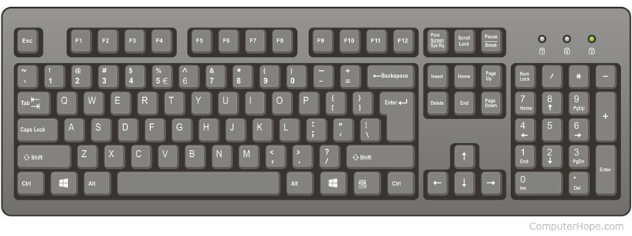
Hack symbols
R0 SP address 0 | R1 LCL address 1 | R2 ARG address 2 | R3 THIS address 3
R4 THAT address 4 | R5 address 5 | R6 address 6 | R7 address 7
R8 address 8 | R9 address 9 | R10 address 10 | R11 address 11
R12 address 12 | R13 address 13 | R14 address 14 | R15 address 15
Variable0 address 16 | Variable1 address 17 | address 18 | …
address x | … | SCREEN row 0, col 0-15 address 16384 | row 0, col 16-31 address 16385
row 0, col 32-48 address 16386 | … | row 0, col 495-511 address 16865 | row 1, col 0-15 address 16866
… | row 1, col 495-511 address 16898 | … | row 255, col 495-511 address 24575
KBD address 24576 | … | Label0 address y | Label1 address y+1
… | address y+z | … | address N
Predefined symbols
Virtual registers: R0 – R15 refer to RAM address 0-15
Predefined pointers: SP, LCL, ARG, THIS, THAT refer to RAM addresses 0-4
I/O pointers: SCREEN and KBD refer to RAM addresses 16384 (0x4000) and 24576 (0x6000),
base addresses of screen and keyboard memory maps
Keyboard: a single-word memory map located in RAM address 24576 (0x6000)
Whenever a key is pressed, its 16-bit ASCII code appears in RAM[24576]
When no key is pressed, the code 0 appears in this location
In addition to the usual ASCII codes, the Hack keyboard recognizes
Word 0
0000000000000000

Slide 119
Hack symbols
R0 SP address 0 | R1 LCL address 1 | R2 ARG address 2 | R3 THIS address 3
R4 THAT address 4 | R5 address 5 | R6 address 6 | R7 address 7
R8 address 8 | R9 address 9 | R10 address 10 | R11 address 11
R12 address 12 | R13 address 13 | R14 address 14 | R15 address 15
Variable0 address 16 | Variable1 address 17 | address 18 | …
address x | … | SCREEN row 0, col 0-15 address 16384 | row 0, col 16-31 address 16385
row 0, col 32-48 address 16386 | … | row 0, col 495-511 address 16865 | row 1, col 0-15 address 16866
… | row 1, col 495-511 address 16898 | … | row 255, col 495-511 address 24575
KBD address 24576 | … | Label0 address y | Label1 address y+1
… | address y+z | … | address N
Predefined symbols
Virtual registers: R0 – R15 refer to RAM address 0-15
Predefined pointers: SP, LCL, ARG, THIS, THAT refer to RAM addresses 0-4
I/O pointers: SCREEN and KBD refer to RAM addresses 16384 (0x4000) and 24576 (0x6000),
base addresses of screen and keyboard memory maps
Keyboard: a single-word memory map located in RAM address 24576 (0x6000)
Whenever a key is pressed, its 16-bit ASCII code appears in RAM[24576]
When no key is pressed, the code 0 appears in this location
In addition to the usual ASCII codes, the Hack keyboard recognizes
Word 0
0000000000000000

Slide 120
Hack symbols
R0 SP address 0 | R1 LCL address 1 | R2 ARG address 2 | R3 THIS address 3
R4 THAT address 4 | R5 address 5 | R6 address 6 | R7 address 7
R8 address 8 | R9 address 9 | R10 address 10 | R11 address 11
R12 address 12 | R13 address 13 | R14 address 14 | R15 address 15
Variable0 address 16 | Variable1 address 17 | address 18 | …
address x | … | SCREEN row 0, col 0-15 address 16384 | row 0, col 16-31 address 16385
row 0, col 32-48 address 16386 | … | row 0, col 495-511 address 16865 | row 1, col 0-15 address 16866
… | row 1, col 495-511 address 16898 | … | row 255, col 495-511 address 24575
KBD address 24576 | … | Label0 address y | Label1 address y+1
… | address y+z | … | address N
Predefined symbols
Virtual registers: R0 – R15 refer to RAM address 0-15
Predefined pointers: SP, LCL, ARG, THIS, THAT refer to RAM addresses 0-4
I/O pointers: SCREEN and KBD refer to RAM addresses 16384 (0x4000) and 24576 (0x6000),
base addresses of screen and keyboard memory maps
Keyboard: a single-word memory map located in RAM address 24576 (0x6000)
Whenever a key is pressed, its 16-bit ASCII code appears in RAM[24576]
When no key is pressed, the code 0 appears in this location
In addition to the usual ASCII codes, the Hack keyboard recognizes
Word 0
0000000000000000

Slide 121
Hack symbols
R0 SP address 0 | R1 LCL address 1 | R2 ARG address 2 | R3 THIS address 3
R4 THAT address 4 | R5 address 5 | R6 address 6 | R7 address 7
R8 address 8 | R9 address 9 | R10 address 10 | R11 address 11
R12 address 12 | R13 address 13 | R14 address 14 | R15 address 15
Variable0 address 16 | Variable1 address 17 | address 18 | …
address x | … | SCREEN row 0, col 0-15 address 16384 | row 0, col 16-31 address 16385
row 0, col 32-48 address 16386 | … | row 0, col 495-511 address 16865 | row 1, col 0-15 address 16866
… | row 1, col 495-511 address 16898 | … | row 255, col 495-511 address 24575
KBD address 24576 | … | Label0 address y | Label1 address y+1
… | address y+z | … | address N
Predefined symbols
Virtual registers: R0 – R15 refer to RAM address 0-15
Predefined pointers: SP, LCL, ARG, THIS, THAT refer to RAM addresses 0-4
I/O pointers: SCREEN and KBD refer to RAM addresses 16384 (0x4000) and 24576 (0x6000),
base addresses of screen and keyboard memory maps
Keyboard: a single-word memory map located in RAM address 24576 (0x6000)
Whenever a key is pressed, its 16-bit ASCII code appears in RAM[24576]
When no key is pressed, the code 0 appears in this location
In addition to the usual ASCII codes, the Hack keyboard recognizes
Word 0
0000000000000000

Slide 122
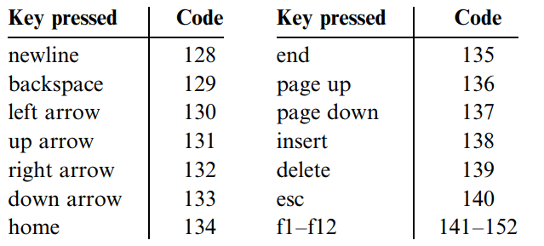
Hack symbols
R0 SP address 0 | R1 LCL address 1 | R2 ARG address 2 | R3 THIS address 3
R4 THAT address 4 | R5 address 5 | R6 address 6 | R7 address 7
R8 address 8 | R9 address 9 | R10 address 10 | R11 address 11
R12 address 12 | R13 address 13 | R14 address 14 | R15 address 15
Variable0 address 16 | Variable1 address 17 | address 18 | …
address x | … | SCREEN row 0, col 0-15 address 16384 | row 0, col 16-31 address 16385
row 0, col 32-48 address 16386 | … | row 0, col 495-511 address 16865 | row 1, col 0-15 address 16866
… | row 1, col 495-511 address 16898 | … | row 255, col 495-511 address 24575
KBD address 24576 | … | Label0 address y | Label1 address y+1
… | address y+z | … | address N
Predefined symbols
Virtual registers: R0 – R15 refer to RAM address 0-15
Predefined pointers: SP, LCL, ARG, THIS, THAT refer to RAM addresses 0-4
I/O pointers: SCREEN and KBD refer to RAM addresses 16384 (0x4000) and 24576 (0x6000),
base addresses of screen and keyboard memory maps
Keyboard: a single-word memory map located in RAM address 24576 (0x6000)
Whenever a key is pressed, its 16-bit ASCII code appears in RAM[24576]
When no key is pressed, the code 0 appears in this location
In addition to the usual ASCII codes, the Hack keyboard recognizes
Word 0
0000000000000000

Slide 123
Hack symbols
R0 SP address 0 | R1 LCL address 1 | R2 ARG address 2 | R3 THIS address 3
R4 THAT address 4 | R5 address 5 | R6 address 6 | R7 address 7
R8 address 8 | R9 address 9 | R10 address 10 | R11 address 11
R12 address 12 | R13 address 13 | R14 address 14 | R15 address 15
Variable0 address 16 | Variable1 address 17 | address 18 | …
address x | … | SCREEN row 0, col 0-15 address 16384 | row 0, col 16-31 address 16385
row 0, col 32-48 address 16386 | … | row 0, col 495-511 address 16865 | row 1, col 0-15 address 16866
… | row 1, col 495-511 address 16898 | … | row 255, col 495-511 address 24575
KBD address 24576 | … | Label0 address y | Label1 address y+1
… | address y+z | … | address N
Predefined symbols
Virtual registers: R0 – R15 refer to RAM address 0-15
Predefined pointers: SP, LCL, ARG, THIS, THAT refer to RAM addresses 0-4
I/O pointers: SCREEN and KBD refer to RAM addresses 16384 (0x4000) and 24576 (0x6000),
base addresses of screen and keyboard memory maps
Keyboard: a single-word memory map located in RAM address 24576 (0x6000)
Whenever a key is pressed, its 16-bit ASCII code appears in RAM[24576]
When no key is pressed, the code 0 appears in this location
In addition to the usual ASCII codes, the Hack keyboard recognizes
Word 0
0000000010000101

Slide 124
Files .hack and .asm
example.hack
Machine language program / binary code file
example.asm
Assembly language program
0 @3 one instruction 0000000000000011
1 D=M another instruction 1111110000010000 2 @5 0000000000000101 3 D=D-A 1110010011010000 4 @Symbol 0000000000010000
5 D;JEQ 1110001100000010 6 @200 0000000011001000
7 0;JMP 1110101010000111
8
case sensitive

Slide 125
Files .hack and .asm
example.hack
Machine language program / binary code file
example.asm
Assembly language program
0 @3 one instruction 0000000000000011
1 D=M another instruction 1111110000010000 2 @5 0000000000000101 3 D=D-A 1110010011010000 4 @Symbol 0000000000010000
5 D;JEQ 1110001100000010 6 @200 0000000011001000
7 0;JMP 1110101010000111
8
case sensitive

Slide 126
Files .hack and .asm
example.hack
Machine language program / binary code file
example.asm
Assembly language program
0 @3 one instruction 0000000000000011
1 D=M another instruction 1111110000010000 2 @5 0000000000000101 3 D=D-A 1110010011010000 4 @Symbol 0000000000010000
5 D;JEQ 1110001100000010 6 @200 0000000011001000
7 0;JMP 1110101010000111
8
Conventions
Constants: non-negative, decimal notation
Symbols: any sequence of a-Z, 0-9, _ , . , $ , :
cannot begin with a digit
Comments: text between // and end of line is ignored
White space: spaces and empty lines ignored
Case:
All assembly mnemonics in uppercase
User-defined labels in uppercase
Variables in lowercase
case sensitive

Slide 127
Files .hack and .asm
example.hack
Machine language program / binary code file
example.asm
Assembly language program
0 @3 one instruction 0000000000000011
1 D=M another instruction 1111110000010000 2 @5 0000000000000101 3 D=D-A 1110010011010000 4 @Symbol 0000000000010000
5 D;JEQ 1110001100000010 6 @200 0000000011001000
7 0;JMP 1110101010000111
8
Conventions
Constants: non-negative, decimal notation
Symbols: any sequence of a-Z, 0-9, _ , . , $ , :
cannot begin with a digit
Comments: text between // and end of line is ignored
White space: spaces and empty lines ignored
Case:
All assembly mnemonics in uppercase
User-defined labels in uppercase
Variables in lowercase
case sensitive

Slide 128
Files .hack and .asm
example.hack
Machine language program / binary code file
example.asm
Assembly language program
0 @3 one instruction 0000000000000011
1 D=M another instruction 1111110000010000 2 @5 0000000000000101 3 D=D-A 1110010011010000 4 @Symbol 0000000000010000
5 D;JEQ 1110001100000010 6 @200 0000000011001000
7 0;JMP 1110101010000111
8
Conventions
Constants: non-negative, decimal notation
Symbols: any sequence of a-Z, 0-9, _ , . , $ , :
cannot begin with a digit
Comments: text between // and end of line is ignored
White space: spaces and empty lines ignored
Case:
All assembly mnemonics in uppercase
User-defined labels in uppercase
Variables in lowercase
case sensitive

Slide 129
Files .hack and .asm
example.hack
Machine language program / binary code file
example.asm
Assembly language program
0 @3 one instruction 0000000000000011
1 D=M another instruction 1111110000010000 2 @5 0000000000000101 3 D=D-A 1110010011010000 4 @Symbol 0000000000010000
5 D;JEQ 1110001100000010 6 @200 0000000011001000
7 0;JMP 1110101010000111
8
Conventions
Constants: non-negative, decimal notation
Symbols: any sequence of a-Z, 0-9, _ , . , $ , :
cannot begin with a digit
Comments: text between // and end of line is ignored
White space: spaces and empty lines ignored
Case:
All assembly mnemonics in uppercase
User-defined labels in uppercase
Variables in lowercase
case sensitive

Slide 130
Files .hack and .asm
example.hack
Machine language program / binary code file
example.asm
Assembly language program
0 @3 one instruction 0000000000000011
1 D=M another instruction 1111110000010000 2 @5 0000000000000101 3 D=D-A 1110010011010000 4 @Symbol 0000000000010000
5 D;JEQ 1110001100000010 6 @200 0000000011001000
7 0;JMP 1110101010000111
8
Conventions
Constants: non-negative, decimal notation
Symbols: any sequence of a-Z, 0-9, _ , . , $ , :
cannot begin with a digit
Comments: text between // and end of line is ignored
White space: spaces and empty lines ignored
Case:
All assembly mnemonics in uppercase
User-defined labels in uppercase
Variables in lowercase
case sensitive

Slide 131
Files .hack and .asm
example.hack
Machine language program / binary code file
example.asm
Assembly language program
0 @3 one instruction 0000000000000011
1 D=M another instruction 1111110000010000 2 @5 0000000000000101 3 D=D-A 1110010011010000 4 @Symbol 0000000000010000
5 D;JEQ 1110001100000010 6 @200 0000000011001000
7 0;JMP 1110101010000111
8
Conventions
Constants: non-negative, decimal notation
Symbols: any sequence of a-Z, 0-9, _ , . , $ , :
cannot begin with a digit
Comments: text between // and end of line is ignored
White space: spaces and empty lines ignored
Case:
All assembly mnemonics in uppercase
User-defined labels in uppercase
Variables in lowercase
case sensitive

Slide 132
Files .hack and .asm
example.hack
Machine language program / binary code file
example.asm
Assembly language program
0 @3 one instruction 0000000000000011
1 D=M another instruction 1111110000010000 2 @5 0000000000000101 3 D=D-A 1110010011010000 4 @Symbol 0000000000010000
5 D;JEQ 1110001100000010 6 @200 0000000011001000
7 0;JMP 1110101010000111
8
Conventions
Constants: non-negative, decimal notation
Symbols: any sequence of a-Z, 0-9, _ , . , $ , :
cannot begin with a digit
Comments: text between // and end of line is ignored
White space: spaces and empty lines ignored
Case:
All assembly mnemonics in uppercase
User-defined labels in uppercase
Variables in lowercase
case sensitive

Slide 133
Files .hack and .asm
example.hack
Machine language program / binary code file
example.asm
Assembly language program
0 @3 one instruction 0000000000000011
1 D=M another instruction 1111110000010000 2 @5 0000000000000101 3 D=D-A 1110010011010000 4 @Symbol 0000000000010000
5 D;JEQ 1110001100000010 6 @200 0000000011001000
7 0;JMP 1110101010000111
8
Conventions
Constants: non-negative, decimal notation
Symbols: any sequence of a-Z, 0-9, _ , . , $ , :
cannot begin with a digit
Comments: text between // and end of line is ignored
White space: spaces and empty lines ignored
Case:
All assembly mnemonics in uppercase
User-defined labels in uppercase
Variables in lowercase
case-senstive
case sensitive

Slide 134
Files .hack and .asm
example.hack
Machine language program / binary code file
example.asm
Assembly language program
0 @3 one instruction 0000000000000011
1 D=M another instruction 1111110000010000 2 @5 0000000000000101 3 D=D-A 1110010011010000 4 @Symbol 0000000000010000
5 D;JEQ 1110001100000010 6 @200 0000000011001000
7 0;JMP 1110101010000111
8
Assembler
Conventions
Constants: non-negative, decimal notation
Symbols: any sequence of a-Z, 0-9, _ , . , $ , :
cannot begin with a digit
Comments: text between // and end of line is ignored
White space: spaces and empty lines ignored
Case:
All assembly mnemonics in uppercase
User-defined labels in uppercase
Variables in lowercase
case-senstive
case sensitive

Slide 135
Files .hack and .asm
example.hack
Machine language program / binary code file
example.asm
Assembly language program
0 @3 one instruction 0000000000000011
1 D=M another instruction 1111110000010000 2 @5 0000000000000101 3 D=D-A 1110010011010000 4 @Symbol 0000000000010000
5 D;JEQ 1110001100000010 6 @200 0000000011001000
7 0;JMP 1110101010000111
8
Assembler
manages all symbols and for replaces them with physical memory addresses
Conventions
Constants: non-negative, decimal notation
Symbols: any sequence of a-Z, 0-9, _ , . , $ , :
cannot begin with a digit
Comments: text between // and end of line is ignored
White space: spaces and empty lines ignored
Case:
All assembly mnemonics in uppercase
User-defined labels in uppercase
Variables in lowercase
case-senstive
case sensitive

Slide 136
Files .hack and .asm
example.hack
Machine language program / binary code file
example.asm
Assembly language program
0 @3 one instruction 0000000000000011
1 D=M another instruction 1111110000010000 2 @5 0000000000000101 3 D=D-A 1110010011010000 4 @Symbol 0000000000010000
5 D;JEQ 1110001100000010 6 @200 0000000011001000
7 0;JMP 1110101010000111
8
Assembler
manages all symbols and for replaces them with physical memory addresses
Conventions
Constants: non-negative, decimal notation
Symbols: any sequence of a-Z, 0-9, _ , . , $ , :
cannot begin with a digit
Comments: text between // and end of line is ignored
White space: spaces and empty lines ignored
Case:
All assembly mnemonics in uppercase
User-defined labels in uppercase
Variables in lowercase
case-senstive
case sensitive

Slide 137
Files .hack and .asm
example.hack
Machine language program / binary code file
example.asm
Assembly language program
0 @3 one instruction 0000000000000011
1 D=M another instruction 1111110000010000 2 @5 0000000000000101 3 D=D-A 1110010011010000 4 @Symbol 0000000000010000
5 D;JEQ 1110001100000010 6 @200 0000000011001000
7 0;JMP 1110101010000111
8
Assembler
manages all symbols and for replaces them with physical memory addresses
Conventions
Constants: non-negative, decimal notation
Symbols: any sequence of a-Z, 0-9, _ , . , $ , :
cannot begin with a digit
Comments: text between // and end of line is ignored
White space: spaces and empty lines ignored
Case:
All assembly mnemonics in uppercase
User-defined labels in uppercase
Variables in lowercase
case-senstive
case sensitive

Slide 138
Files .hack and .asm
example.hack
Machine language program / binary code file
example.asm
Assembly language program
0 @3 one instruction 0000000000000011
1 D=M another instruction 1111110000010000 2 @5 0000000000000101 3 D=D-A 1110010011010000 4 @Symbol 0000000000010000
5 D;JEQ 1110001100000010 6 @200 0000000011001000
7 0;JMP 1110101010000111
8
Assembler
manages all symbols and for replaces them with physical memory addresses
Conventions
Constants: non-negative, decimal notation
Symbols: any sequence of a-Z, 0-9, _ , . , $ , :
cannot begin with a digit
Comments: text between // and end of line is ignored
White space: spaces and empty lines ignored
Case:
All assembly mnemonics in uppercase
User-defined labels in uppercase
Variables in lowercase
case-senstive
case sensitive

Slide 139
Files .hack and .asm
example.hack
Machine language program / binary code file
example.asm
Assembly language program
0 @3 one instruction 0000000000000011
1 D=M another instruction 1111110000010000 2 @5 0000000000000101 3 D=D-A 1110010011010000 4 @Symbol 0000000000010000
5 D;JEQ 1110001100000010 6 @200 0000000011001000
7 0;JMP 1110101010000111
8
Assembler
manages all symbols and for replaces them with physical memory addresses
Conventions
Constants: non-negative, decimal notation
Symbols: any sequence of a-Z, 0-9, _ , . , $ , :
cannot begin with a digit
Comments: text between // and end of line is ignored
White space: spaces and empty lines ignored
Case:
All assembly mnemonics in uppercase
User-defined labels in uppercase
Variables in lowercase
case-senstive
case sensitive

Slide 140
Files .hack and .asm
example.hack
Machine language program / binary code file
example.asm
Assembly language program
0 @3 one instruction 0000000000000011
1 D=M another instruction 1111110000010000 2 @5 0000000000000101 3 D=D-A 1110010011010000 4 @Symbol 0000000000010000
5 D;JEQ 1110001100000010 6 @200 0000000011001000
7 0;JMP 1110101010000111
8
Assembler
manages all symbols and for replaces them with physical memory addresses
Conventions
Constants: non-negative, decimal notation
Symbols: any sequence of a-Z, 0-9, _ , . , $ , :
cannot begin with a digit
Comments: text between // and end of line is ignored
White space: spaces and empty lines ignored
Case:
All assembly mnemonics in uppercase
User-defined labels in uppercase
Variables in lowercase
Instruction Memory
0000000000000011 address 0 | 1111110000010000 address 1 | 0000000000000101 address 2 | 1110010011010000 address 3
R4 THAT 0000000000010000 address 4 | R5 1110001100000010 address 5 | R60000000011001000 address 6 | R7 1110101010000111 address 7
R8 address 8 | R9 address 9 | R10 … | R11 address n
case-senstive
case sensitive

Slide 141
Files .hack and .asm
example.hack
Machine language program / binary code file
example.asm
Assembly language program
0 @3 one instruction 0000000000000011
1 D=M another instruction 1111110000010000 2 @5 0000000000000101 3 D=D-A 1110010011010000 4 @Symbol 0000000000010000
5 D;JEQ 1110001100000010 6 @200 0000000011001000
7 0;JMP 1110101010000111
8
Assembler
manages all symbols and for replaces them with physical memory addresses
Conventions
Constants: non-negative, decimal notation
Symbols: any sequence of a-Z, 0-9, _ , . , $ , :
cannot begin with a digit
Comments: text between // and end of line is ignored
White space: spaces and empty lines ignored
Case:
All assembly mnemonics in uppercase
User-defined labels in uppercase
Variables in lowercase
Instruction Memory
0000000000000011 address 0 | 1111110000010000 address 1 | 0000000000000101 address 2 | 1110010011010000 address 3
R4 THAT 0000000000010000 address 4 | R5 1110001100000010 address 5 | R60000000011001000 address 6 | R7 1110101010000111 address 7
R8 address 8 | R9 address 9 | R10 … | R11 address n
case-senstive
case sensitive

Slide 142
Files .hack and .asm
example.hack
Machine language program / binary code file
example.asm
Assembly language program
0 @3 one instruction 0000000000000011
1 D=M another instruction 1111110000010000 2 @5 0000000000000101 3 D=D-A 1110010011010000 4 @Symbol 0000000000010000
5 D;JEQ 1110001100000010 6 @200 0000000011001000
7 0;JMP 1110101010000111
8
Assembler
manages all symbols and for replaces them with physical memory addresses
Conventions
Constants: non-negative, decimal notation
Symbols: any sequence of a-Z, 0-9, _ , . , $ , :
cannot begin with a digit
Comments: text between // and end of line is ignored
White space: spaces and empty lines ignored
Case:
All assembly mnemonics in uppercase
User-defined labels in uppercase
Variables in lowercase
Instruction Memory
0000000000000011 address 0 | 1111110000010000 address 1 | 0000000000000101 address 2 | 1110010011010000 address 3
R4 THAT 0000000000010000 address 4 | R5 1110001100000010 address 5 | R60000000011001000 address 6 | R7 1110101010000111 address 7
R8 address 8 | R9 address 9 | R10 … | R11 address n
case-senstive
case sensitive

Slide 143
Files .hack and .asm
example.hack
Machine language program / binary code file
example.asm
Assembly language program
0 @3 one instruction 0000000000000011
1 D=M another instruction 1111110000010000 2 @5 0000000000000101 3 D=D-A 1110010011010000 4 @Symbol 0000000000010000
5 D;JEQ 1110001100000010 6 @200 0000000011001000
7 0;JMP 1110101010000111
8
Assembler
manages all symbols and for replaces them with physical memory addresses
Conventions
Constants: non-negative, decimal notation
Symbols: any sequence of a-Z, 0-9, _ , . , $ , :
cannot begin with a digit
Comments: text between // and end of line is ignored
White space: spaces and empty lines ignored
Case:
All assembly mnemonics in uppercase
User-defined labels in uppercase
Variables in lowercase
Instruction Memory
0000000000000011 address 0 | 1111110000010000 address 1 | 0000000000000101 address 2 | 1110010011010000 address 3
R4 THAT 0000000000010000 address 4 | R5 1110001100000010 address 5 | R60000000011001000 address 6 | R7 1110101010000111 address 7
R8 address 8 | R9 address 9 | R10 … | R11 address n
case-senstive
case sensitive

Slide 144
Files .hack and .asm
example.hack
Machine language program / binary code file
example.asm
Assembly language program
0 @3 one instruction 0000000000000011
1 D=M another instruction 1111110000010000 2 @5 0000000000000101 3 D=D-A 1110010011010000 4 @Symbol 0000000000010000
5 D;JEQ 1110001100000010 6 @200 0000000011001000
7 0;JMP 1110101010000111
8
Assembler
manages all symbols and for replaces them with physical memory addresses
Conventions
Constants: non-negative, decimal notation
Symbols: any sequence of a-Z, 0-9, _ , . , $ , :
cannot begin with a digit
Comments: text between // and end of line is ignored
White space: spaces and empty lines ignored
Case:
All assembly mnemonics in uppercase
User-defined labels in uppercase
Variables in lowercase
Instruction Memory
0000000000000011 address 0 | 1111110000010000 address 1 | 0000000000000101 address 2 | 1110010011010000 address 3
R4 THAT 0000000000010000 address 4 | R5 1110001100000010 address 5 | R60000000011001000 address 6 | R7 1110101010000111 address 7
R8 address 8 | R9 address 9 | R10 … | R11 address n
case-senstive
case sensitive

Slide 145

Perspective
The Hack machine language is simplified, its 16-bit ASCII code appears in RAM[24576]
Most computers have more instructions, more data types, more registers, more instruction formats, and more addressing modes
Any feature not supported may still be implemented in software, at a performance cost
Eg. multiplication and division will be implemented at the operating system level (chapter 12)
C-instruction
D=M LOAD M
D=D+M ADD D+M
‘‘1 2 address machine’’
16 bits $→$ no room for both instruction and address $→$ A- and C- instructions
Most machine languages can directly specify at least one address in every machine instruction
Eg.
@xxx
D=D+M
@YYY
0;JMP

Slide 146

Perspective
The Hack machine language is simplified, its 16-bit ASCII code appears in RAM[24576]
Most computers have more instructions, more data types, more registers, more instruction formats, and more addressing modes
Any feature not supported may still be implemented in software, at a performance cost
Eg. multiplication and division will be implemented at the operating system level (chapter 12)
C-instruction
D=M LOAD M
D=D+M ADD D+M
‘‘1 2 address machine’’
16 bits $→$ no room for both instruction and address $→$ A- and C- instructions
Most machine languages can directly specify at least one address in every machine instruction
Eg.
@xxx
D=D+M
@YYY
0;JMP

Slide 147

Perspective
The Hack machine language is simplified, its 16-bit ASCII code appears in RAM[24576]
Most computers have more instructions, more data types, more registers, more instruction formats, and more addressing modes
Any feature not supported may still be implemented in software, at a performance cost
Eg. multiplication and division will be implemented at the operating system level (chapter 12)
C-instruction
D=M LOAD M
D=D+M ADD D+M
‘‘1 2 address machine’’
16 bits $→$ no room for both instruction and address $→$ A- and C- instructions
Most machine languages can directly specify at least one address in every machine instruction
Eg.
@xxx
D=D+M
@YYY
0;JMP

Slide 148

Perspective
The Hack machine language is simplified, its 16-bit ASCII code appears in RAM[24576]
Most computers have more instructions, more data types, more registers, more instruction formats, and more addressing modes
Any feature not supported may still be implemented in software, at a performance cost
Eg. multiplication and division will be implemented at the operating system level (chapter 12)
C-instruction
D=M LOAD M
D=D+M ADD D+M
‘‘1 2 address machine’’
16 bits $→$ no room for both instruction and address $→$ A- and C- instructions
Most machine languages can directly specify at least one address in every machine instruction
Eg.
@xxx
D=D+M
@YYY
0;JMP

Slide 149

Perspective
The Hack machine language is simplified, its 16-bit ASCII code appears in RAM[24576]
Most computers have more instructions, more data types, more registers, more instruction formats, and more addressing modes
Any feature not supported may still be implemented in software, at a performance cost
Eg. multiplication and division will be implemented at the operating system level (chapter 12)
C-instruction
D=M LOAD M
D=D+M ADD D+M
‘‘1 2 address machine’’
16 bits $→$ no room for both instruction and address $→$ A- and C- instructions
Most machine languages can directly specify at least one address in every machine instruction
Eg.
@xxx
D=D+M
@YYY
0;JMP

Slide 150

Perspective
The Hack machine language is simplified, its 16-bit ASCII code appears in RAM[24576]
Most computers have more instructions, more data types, more registers, more instruction formats, and more addressing modes
Any feature not supported may still be implemented in software, at a performance cost
Eg. multiplication and division will be implemented at the operating system level (chapter 12)
C-instruction
D=M LOAD M
D=D+M ADD D+M
‘‘1 2 address machine’’
16 bits $→$ no room for both instruction and address $→$ A- and C- instructions
Most machine languages can directly specify at least one address in every machine instruction
Eg.
@xxx
D=D+M
@YYY
0;JMP

Slide 151

Perspective
The Hack machine language is simplified, its 16-bit ASCII code appears in RAM[24576]
Most computers have more instructions, more data types, more registers, more instruction formats, and more addressing modes
Any feature not supported may still be implemented in software, at a performance cost
Eg. multiplication and division will be implemented at the operating system level (chapter 12)
C-instruction
D=M LOAD M
D=D+M ADD D+M
‘‘1 2 address machine’’
16 bits $→$ no room for both instruction and address $→$ A- and C- instructions
Most machine languages can directly specify at least one address in every machine instruction
Eg.
@xxx
D=D+M
@YYY
0;JMP

Slide 152

Perspective
The Hack machine language is simplified, its 16-bit ASCII code appears in RAM[24576]
Most computers have more instructions, more data types, more registers, more instruction formats, and more addressing modes
Any feature not supported may still be implemented in software, at a performance cost
Eg. multiplication and division will be implemented at the operating system level (chapter 12)
C-instruction
D=M LOAD M
D=D+M ADD D+M
‘‘1 2 address machine’’
16 bits $→$ no room for both instruction and address $→$ A- and C- instructions
Most machine languages can directly specify at least one address in every machine instruction
Eg.
@xxx
D=D+M
@YYY
0;JMP

Slide 153

Perspective
The Hack machine language is simplified, its 16-bit ASCII code appears in RAM[24576]
Most computers have more instructions, more data types, more registers, more instruction formats, and more addressing modes
Any feature not supported may still be implemented in software, at a performance cost
Eg. multiplication and division will be implemented at the operating system level (chapter 12)
C-instruction
D=M LOAD M
D=D+M ADD D+M
‘‘1 2 address machine’’
16 bits $→$ no room for both instruction and address $→$ A- and C- instructions
Most machine languages can directly specify at least one address in every machine instruction
Eg.
@xxx
D=D+M
@YYY
0;JMP

Slide 154

Perspective
The Hack machine language is simplified, its 16-bit ASCII code appears in RAM[24576]
Most computers have more instructions, more data types, more registers, more instruction formats, and more addressing modes
Any feature not supported may still be implemented in software, at a performance cost
Eg. multiplication and division will be implemented at the operating system level (chapter 12)
C-instruction
D=M LOAD M
D=D+M ADD D+M
‘‘1 2 address machine’’
16 bits $→$ no room for both instruction and address $→$ A- and C- instructions
Most machine languages can directly specify at least one address in every machine instruction
Eg.
@xxx
D=D+M
@YYY
0;JMP

Slide 155
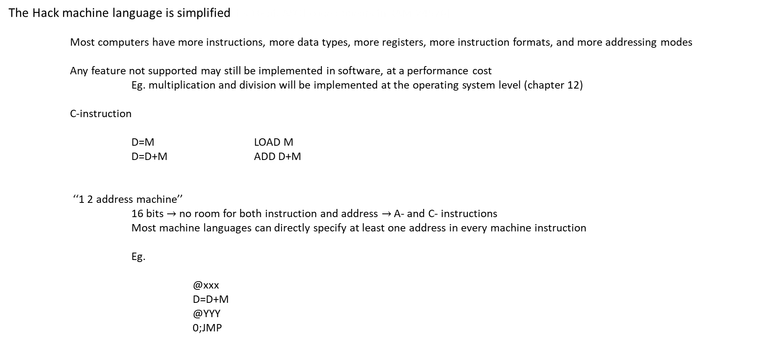
Perspective
The Hack machine language is simplified, its 16-bit ASCII code appears in RAM[24576]
Most computers have more instructions, more data types, more registers, more instruction formats, and more addressing modes
Any feature not supported may still be implemented in software, at a performance cost
Eg. multiplication and division will be implemented at the operating system level (chapter 12)
C-instruction
D=M LOAD M
D=D+M ADD D+M
‘‘1 2 address machine’’
16 bits $→$ no room for both instruction and address $→$ A- and C- instructions
Most machine languages can directly specify at least one address in every machine instruction
Eg.
@xxx
D=D+M
@YYY
0;JMP

Slide 156
Perspective
The Hack machine language is simplified, its 16-bit ASCII code appears in RAM[24576]
Most computers have more instructions, more data types, more registers, more instruction formats, and more addressing modes
Any feature not supported may still be implemented in software, at a performance cost
Eg. multiplication and division will be implemented at the operating system level (chapter 12)
C-instruction
D=M LOAD M
D=D+M ADD D+M
‘‘1 2 address machine’’
16 bits $→$ no room for both instruction and address $→$ A- and C- instructions
Most machine languages can directly specify at least one address in every machine instruction
Eg.
@xxx
D=D+M
@YYY
0;JMP
If tedious or peculiar, in chapter 6 we can modify the assembler to them

Slide 157
Perspective
The Hack machine language is simplified, its 16-bit ASCII code appears in RAM[24576]
Most computers have more instructions, more data types, more registers, more instruction formats, and more addressing modes
Any feature not supported may still be implemented in software, at a performance cost
Eg. multiplication and division will be implemented at the operating system level (chapter 12)
C-instruction
D=M LOAD M
D=D+M ADD D+M
‘‘1 2 address machine’’
16 bits $→$ no room for both instruction and address $→$ A- and C- instructions
Most machine languages can directly specify at least one address in every machine instruction
Eg.
@xxx
D=D+M
@YYY
0;JMP
If tedious or peculiar, in chapter 6 we can modify the assembler to them
D=D+M[xxx]
GOTO YYY

Slide 158
Exercises mult.asm
// Multiplies R0 and R1 and stores the result in R2.
// (R0, R1, R2 refer to RAM[0], RAM[1], and RAM[2], respectively.)
// Initialize R2=0
@R2
M=0
// If R0=0 or R1=0, R2=0 already so exit
@R0
D=M
@END // R0=0?
D;JEQ
@R1
D=M
@END // R1=0?
D;JEQ
(LOOP)
// Add R0 to R2 and store in R2, decrementing R1
@R0
D=M
@R2 // Add R0 to current sum (R2)
M=D+M
@R1 // Decrement R1
MD=M-1
@END // If R1 has dropped to 0, exit
D;JEQ
@LOOP // Otherwise, keep adding
0;JMP
(END)
@END
0;JMP

Slide 159
Exercises mult.asm
// Multiplies R0 and R1 and stores the result in R2.
// (R0, R1, R2 refer to RAM[0], RAM[1], and RAM[2], respectively.)
// Initialize R2=0
@R2
M=0
// If R0=0 or R1=0, R2=0 already so exit
@R0
D=M
@END // R0=0?
D;JEQ
@R1
D=M
@END // R1=0?
D;JEQ
(LOOP)
// Add R0 to R2 and store in R2, decrementing R1
@R0
D=M
@R2 // Add R0 to current sum (R2)
M=D+M
@R1 // Decrement R1
MD=M-1
@END // If R1 has dropped to 0, exit
D;JEQ
@LOOP // Otherwise, keep adding
0;JMP
(END)
@END
0;JMP

Slide 160
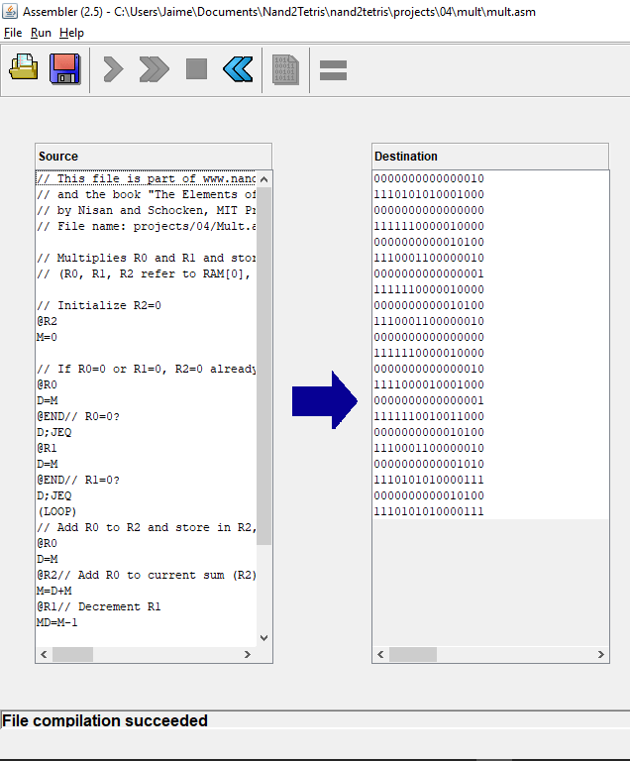
Exercises mult.asm
1 compile
// Multiplies R0 and R1 and stores the result in R2.
// (R0, R1, R2 refer to RAM[0], RAM[1], and RAM[2], respectively.)
// Initialize R2=0
@R2
M=0
// If R0=0 or R1=0, R2=0 already so exit
@R0
D=M
@END // R0=0?
D;JEQ
@R1
D=M
@END // R1=0?
D;JEQ
(LOOP)
// Add R0 to R2 and store in R2, decrementing R1
@R0
D=M
@R2 // Add R0 to current sum (R2)
M=D+M
@R1 // Decrement R1
MD=M-1
@END // If R1 has dropped to 0, exit
D;JEQ
@LOOP // Otherwise, keep adding
0;JMP
(END)
@END
0;JMP

Slide 161
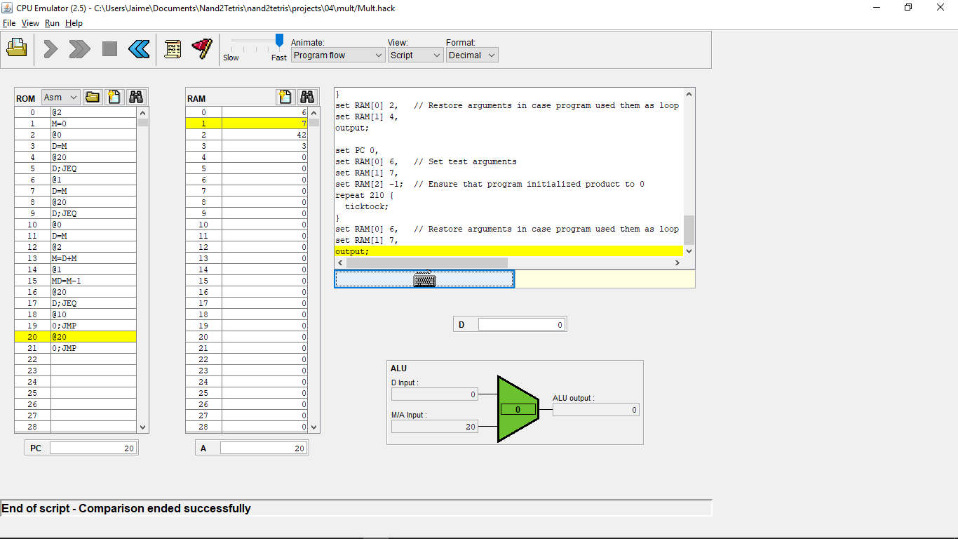
Exercises mult.asm
1 compile
// Multiplies R0 and R1 and stores the result in R2.
// (R0, R1, R2 refer to RAM[0], RAM[1], and RAM[2], respectively.)
// Initialize R2=0
@R2
M=0
// If R0=0 or R1=0, R2=0 already so exit
@R0
D=M
@END // R0=0?
D;JEQ
@R1
D=M
@END // R1=0?
D;JEQ
(LOOP)
// Add R0 to R2 and store in R2, decrementing R1
@R0
D=M
@R2 // Add R0 to current sum (R2)
M=D+M
@R1 // Decrement R1
MD=M-1
@END // If R1 has dropped to 0, exit
D;JEQ
@LOOP // Otherwise, keep adding
0;JMP
(END)
@END
0;JMP
2 test

Slide 162
Exercises fill.asm
// Runs an infinite loop that listens to the keyboard input.
// When a key is pressed (any key), the program blackens the screen,
// i.e. writes "black" in every pixel;
// the screen should remain fully black as long as the key is pressed.
// When no key is pressed, the program clears the screen, i.e. writes
// "white" in every pixel;
// the screen should remain fully clear as long as no key is pressed.
// Main loop that decides sub-loop to take (blacken or whiten screen) depending on
// whether a key is being pressed
(LOOP)
// Put base address of screen (18384) into R0 so that R0 can be incremented
@SCREEN
D=A
@pixelsWord
M=D
// Decide on black or white path depending on key pressed or not
@KBD
D=M
@BLACK
D;JNE
@WHITE
D;JEQ
// Keep polling for a key press
@LOOP
0;JMP
(BLACK)
// If R0 has reached end of screen (24575), go back to main loop to reset R0 to start of screen (18384)
@pixelsWord // Check the value that R0 is holding (the address of the current screen word)
D=M
@24576 // 24576 is the KBD and 24577 is an illegal address
D=D-A
@LOOP
D;JEQ
// Else, R0 is still within the start and end of screen, so fill the word with all 1's
@pixelsWord // Set the address to the value that R0 is holding
A=M
M=-1 // Fill current word with 1111111111111111
@pixelsWord // Move on to the next word in the screen
M=M+1
// If the key is no longer pressed, return to main loop
@KBD
D=M
@LOOP
D;JEQ
// Else, continue filling the rest of the screen with 1's
@BLACK
D;JNE
(WHITE)
// If R0 has reached end of screen (24575), go back to main loop to reset R0 to start of screen (18384)
@pixelsWord // Check the value that R0 is holding (the address of the current screen word)
D=M
@24576 // 24576 is the KBD and 24577 is an illegal address
D=D-A
@LOOP
D;JEQ

Slide 163
Exercises fill.asm
// Runs an infinite loop that listens to the keyboard input.
// When a key is pressed (any key), the program blackens the screen,
// i.e. writes "black" in every pixel;
// the screen should remain fully black as long as the key is pressed.
// When no key is pressed, the program clears the screen, i.e. writes
// "white" in every pixel;
// the screen should remain fully clear as long as no key is pressed.
// Main loop that decides sub-loop to take (blacken or whiten screen) depending on
// whether a key is being pressed
(LOOP)
// Put base address of screen (18384) into R0 so that R0 can be incremented
@SCREEN
D=A
@pixelsWord
M=D
// Decide on black or white path depending on key pressed or not
@KBD
D=M
@BLACK
D;JNE
@WHITE
D;JEQ
// Keep polling for a key press
@LOOP
0;JMP
(BLACK)
// If R0 has reached end of screen (24575), go back to main loop to reset R0 to start of screen (18384)
@pixelsWord // Check the value that R0 is holding (the address of the current screen word)
D=M
@24576 // 24576 is the KBD and 24577 is an illegal address
D=D-A
@LOOP
D;JEQ
// Else, R0 is still within the start and end of screen, so fill the word with all 1's
@pixelsWord // Set the address to the value that R0 is holding
A=M
M=-1 // Fill current word with 1111111111111111
@pixelsWord // Move on to the next word in the screen
M=M+1
// If the key is no longer pressed, return to main loop
@KBD
D=M
@LOOP
D;JEQ
// Else, continue filling the rest of the screen with 1's
@BLACK
D;JNE
(WHITE)
// If R0 has reached end of screen (24575), go back to main loop to reset R0 to start of screen (18384)
@pixelsWord // Check the value that R0 is holding (the address of the current screen word)
D=M
@24576 // 24576 is the KBD and 24577 is an illegal address
D=D-A
@LOOP
D;JEQ
…etc. analogously for the white

Slide 164
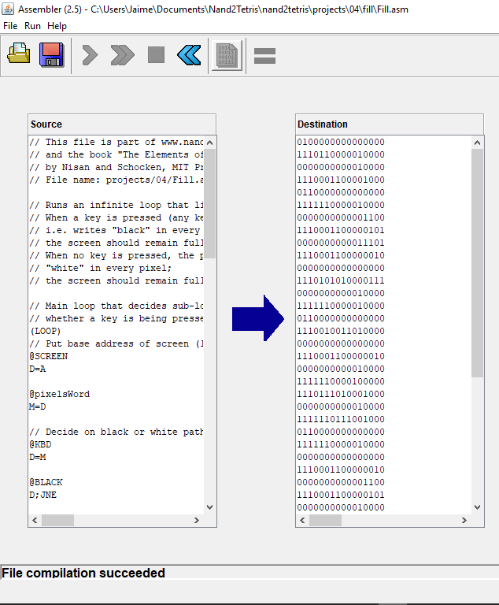
Exercises fill.asm
1 compile
// Runs an infinite loop that listens to the keyboard input.
// When a key is pressed (any key), the program blackens the screen,
// i.e. writes "black" in every pixel;
// the screen should remain fully black as long as the key is pressed.
// When no key is pressed, the program clears the screen, i.e. writes
// "white" in every pixel;
// the screen should remain fully clear as long as no key is pressed.
// Main loop that decides sub-loop to take (blacken or whiten screen) depending on
// whether a key is being pressed
(LOOP)
// Put base address of screen (18384) into R0 so that R0 can be incremented
@SCREEN
D=A
@pixelsWord
M=D
// Decide on black or white path depending on key pressed or not
@KBD
D=M
@BLACK
D;JNE
@WHITE
D;JEQ
// Keep polling for a key press
@LOOP
0;JMP
(BLACK)
// If R0 has reached end of screen (24575), go back to main loop to reset R0 to start of screen (18384)
@pixelsWord // Check the value that R0 is holding (the address of the current screen word)
D=M
@24576 // 24576 is the KBD and 24577 is an illegal address
D=D-A
@LOOP
D;JEQ
// Else, R0 is still within the start and end of screen, so fill the word with all 1's
@pixelsWord // Set the address to the value that R0 is holding
A=M
M=-1 // Fill current word with 1111111111111111
@pixelsWord // Move on to the next word in the screen
M=M+1
// If the key is no longer pressed, return to main loop
@KBD
D=M
@LOOP
D;JEQ
// Else, continue filling the rest of the screen with 1's
@BLACK
D;JNE
(WHITE)
// If R0 has reached end of screen (24575), go back to main loop to reset R0 to start of screen (18384)
@pixelsWord // Check the value that R0 is holding (the address of the current screen word)
D=M
@24576 // 24576 is the KBD and 24577 is an illegal address
D=D-A
@LOOP
D;JEQ
…etc. analogously for the white

Slide 165
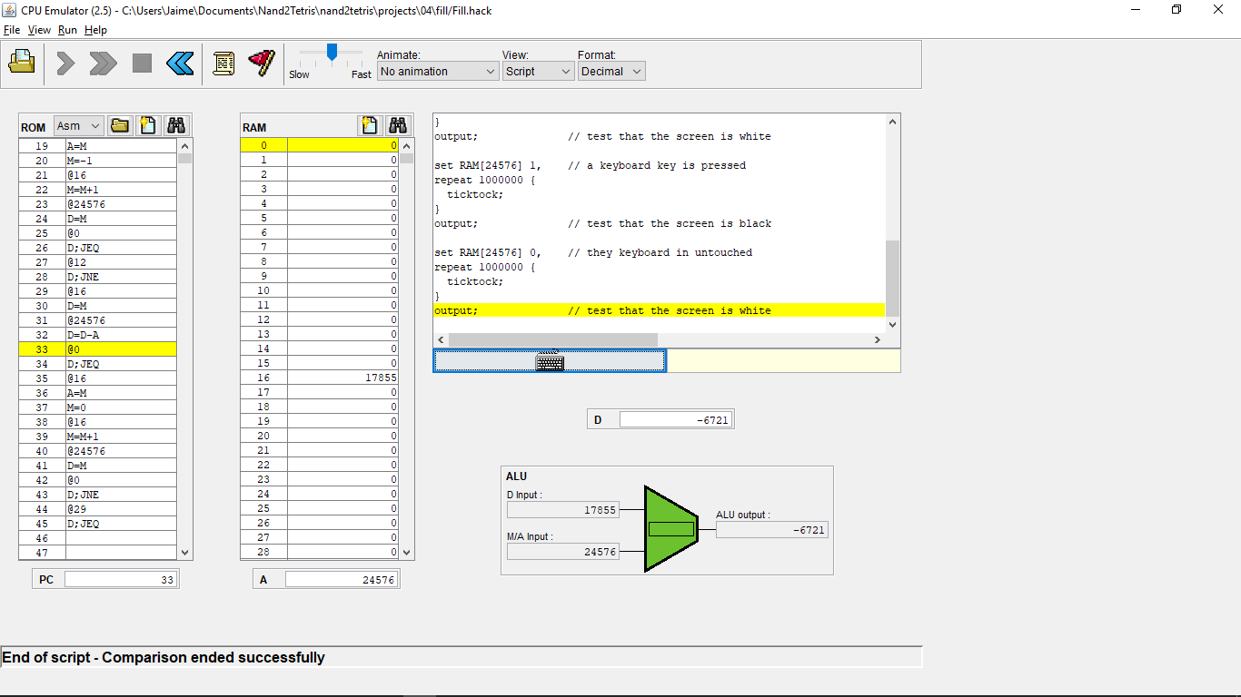
Exercises fill.asm
1 compile
// Runs an infinite loop that listens to the keyboard input.
// When a key is pressed (any key), the program blackens the screen,
// i.e. writes "black" in every pixel;
// the screen should remain fully black as long as the key is pressed.
// When no key is pressed, the program clears the screen, i.e. writes
// "white" in every pixel;
// the screen should remain fully clear as long as no key is pressed.
// Main loop that decides sub-loop to take (blacken or whiten screen) depending on
// whether a key is being pressed
(LOOP)
// Put base address of screen (18384) into R0 so that R0 can be incremented
@SCREEN
D=A
@pixelsWord
M=D
// Decide on black or white path depending on key pressed or not
@KBD
D=M
@BLACK
D;JNE
@WHITE
D;JEQ
// Keep polling for a key press
@LOOP
0;JMP
(BLACK)
// If R0 has reached end of screen (24575), go back to main loop to reset R0 to start of screen (18384)
@pixelsWord // Check the value that R0 is holding (the address of the current screen word)
D=M
@24576 // 24576 is the KBD and 24577 is an illegal address
D=D-A
@LOOP
D;JEQ
// Else, R0 is still within the start and end of screen, so fill the word with all 1's
@pixelsWord // Set the address to the value that R0 is holding
A=M
M=-1 // Fill current word with 1111111111111111
@pixelsWord // Move on to the next word in the screen
M=M+1
// If the key is no longer pressed, return to main loop
@KBD
D=M
@LOOP
D;JEQ
// Else, continue filling the rest of the screen with 1's
@BLACK
D;JNE
(WHITE)
// If R0 has reached end of screen (24575), go back to main loop to reset R0 to start of screen (18384)
@pixelsWord // Check the value that R0 is holding (the address of the current screen word)
D=M
@24576 // 24576 is the KBD and 24577 is an illegal address
D=D-A
@LOOP
D;JEQ
2 test
…etc. analogously for the white

